Slide 1
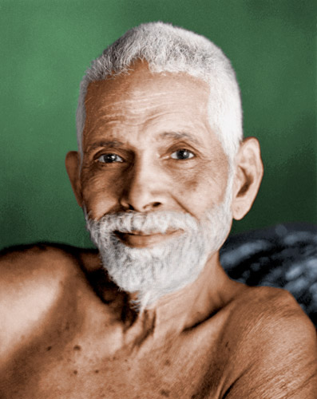
Om Namo Bhagavate Sri Ramanaya

Slide 2
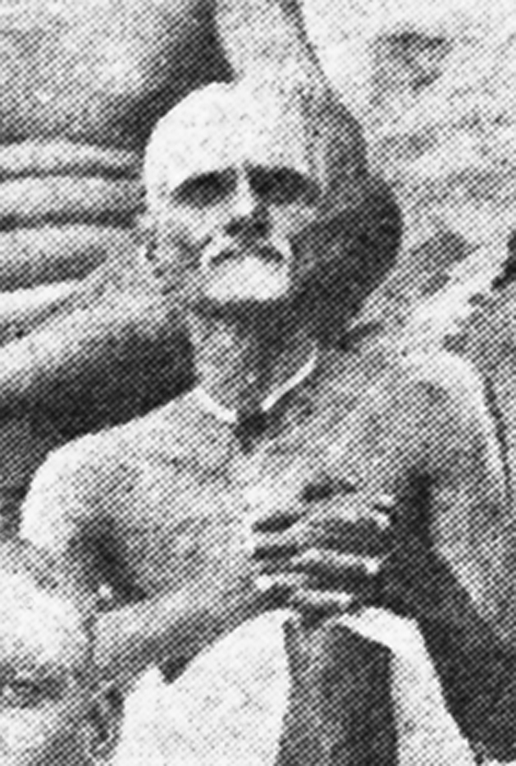
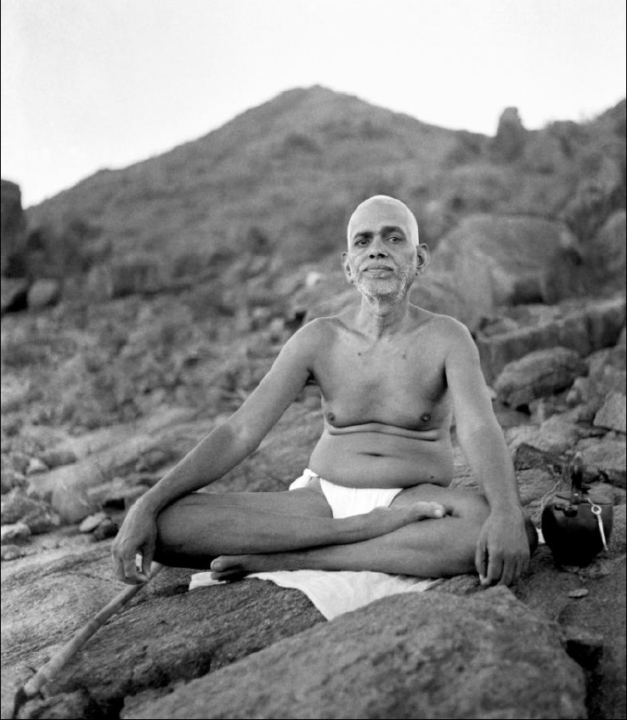
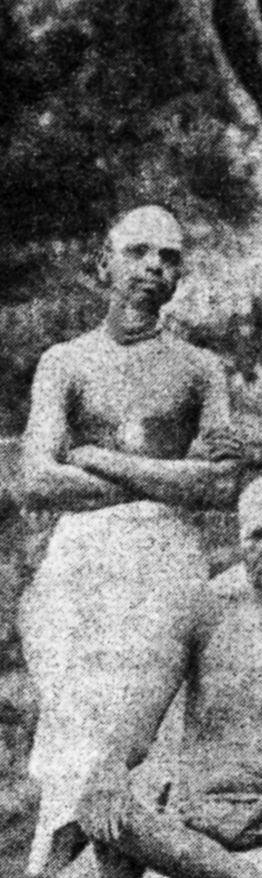
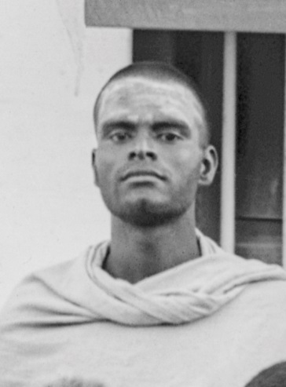
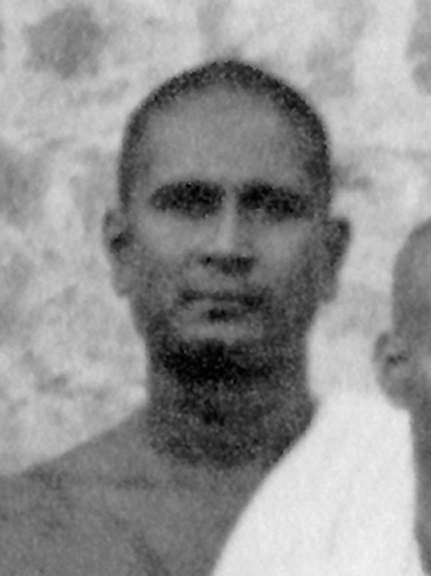
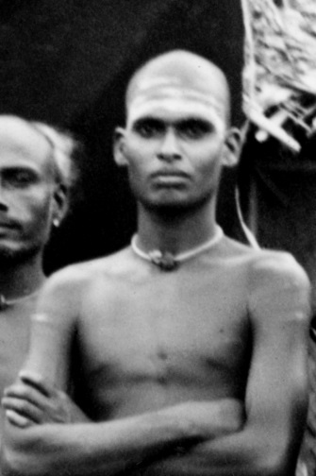
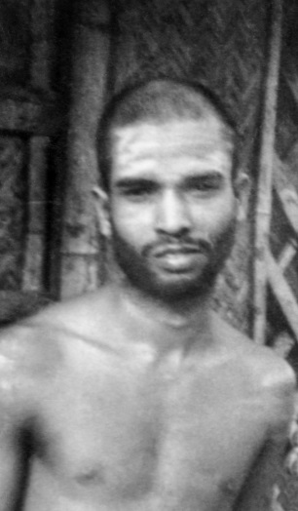
Pazhani Swami
Ayya Swami
Kunju Swami
Ramakrishna Swami
Devotees from Kerala who served as attendants of Bhagavan
Madhava Swami
Satyananda Swami

Slide 3
Supplication
Anbodun namangal anbardam anbaruk
Anbanayida arul Arunachala.
Akshara manamalai verse 104
O Arunachala! Bestow Your Grace so that I may graciously become a devotee of the devotees of those who hear Your name with love.

Slide 4
Supplication
Anburu Arunachalavazhan mezhukai
Agattunai ninaindunaindu urugum
Anbillai yenakku un anbinai arulaadu
Aandu enai azhitidal azhago?
…. Arunachala Padikam verse 2
O Arunachala! The form of love! I am devoid of that love by which I would think of You in the Heart and soften and melt like wax in fire. Having taken me as Your own, does it befit You now, to ruin me by not bestowing love for you in me?

Slide 5
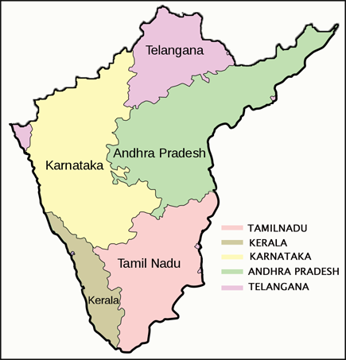

Map of South India
Thiruvannamalai

Slide 6
Acknowledgements
Dennis
Tampa retreat organizers :Diana , Mathy,Janet, David
Proof correction: Anil, Bandhu, Hari
Material support: Darlene, Evelyn, Arthur
John Maynard for some of the pictures
References
Arunachala Ramana e-book
Self Realization… BV Narasimha Swami
Ramana Maharshi and Path of Self Knowledge….Arthur Osborne
Ramana Leela….Krishna Bhikshu
Kunju Swami Reminiscences
Reminiscences of GV Subbaramayya
Day by Day with Bhagavan…Devaraja Mudaliar
Talks with Ramana Maharshi…Mungala Venkataramayya
Letters From Ramanashramam … Suri Nagamma
Sadhu’s Reminiscences…. Major Chadwick
Ramana Periya Puranam … V Ganeshan
Mountain Path periodicals
The Maharshi Newletters
Sri Nochur Venkataraman’s Discourses

Slide 7
Attendant’s attitude towards Bhagavan
“Bhagavan used to sleep on the sofa and attendants on the floor.
Bhagavan never had to call us by name or wake us up. Bhagavan’s look in our direction produced a sense of brilliant light in us and we used to wake up at once.
Bhagavan never ordered his servants about.
But the attendants would always anticipate his wishes and do what was necessary.”
Kunju Swami…. Arunachala Ramana Eternal Ocean of Grace

Slide 8
Particulars of Bhagavan’s nature
Ocean of compassion
Soulabhya (always available)
Equanimity
Regularity and Punctuality
Never ask for anything
Strict
Personalized attention

Slide 9
Bhagavan’s advent and initial days
1896 Sept 1 Advent
Total absorbtion in Self and utter neglect of body
State in Patala Linga (insects eating up flesh) Gurumurtham (body got stuck with wall)

Slide 10
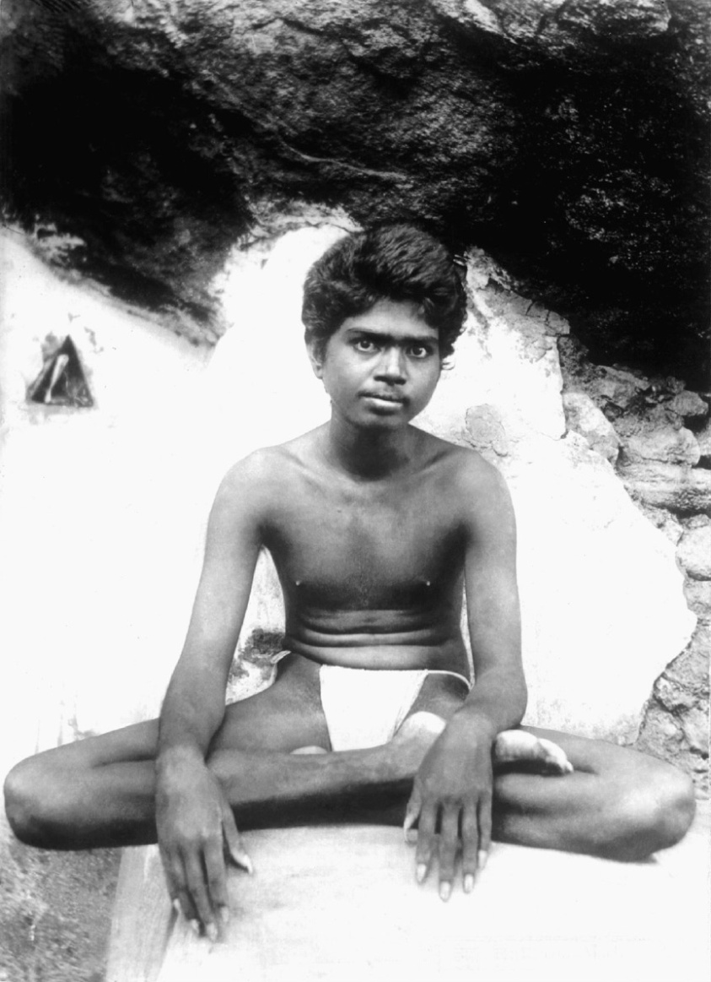
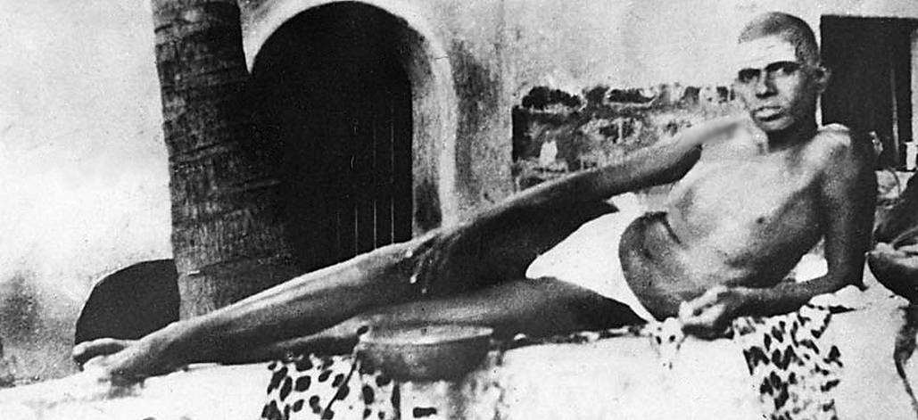

Slide 11
Bhagavan: initial days
“For something like a year I was eating only one meal a day. At Gurumurtham, I was only skin and bone, no flesh anywhere. All the bones were sticking out, collar bone, ribs, and the hip bones. There was no stomach to be seen. It was sticking to the back.”
…Day by Day 6th February 1946 Night
No shave for year and a half
The matted hair on the head spread out and hung down like the
mane of a lion.
When my head was shaven clean, I began to wonder whether I had a head or not, it felt so light.
had long nails, and a frightful appearance
..Letters Chapter 177

Slide 12
Bhagavan: initial days
“After I came to this place, Thiruvannamalai, I had no bath for four months. who was to make me bathe? Who was the one to bathe?”
First bath in the compound of the Arunachala Temple, the wife of a devotee named Ponnuswami,
After an year or so, a lady by name Minakshi gave another bath forcefully in Gurumurtham.
“After that, Pazhaniswami came and everything was adjusted into routine of daily baths.”

Slide 13
Pazhani Swami and Ayya Swami
Enpolum deenarai enbura kattrunee
Ennalum vazhndu arul Arunachala!
.. Akshara manamalai verse 105
O Arunachala, Graciously live forever protecting helpless devotees like me in such a way that they attain Bliss.

Slide 14
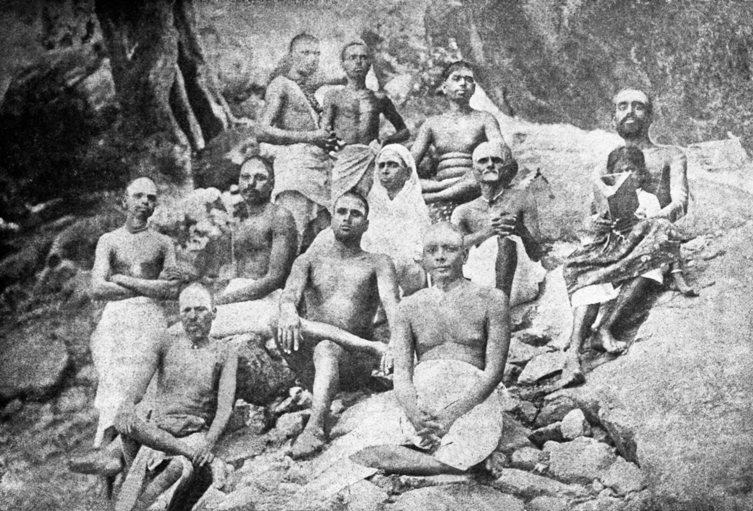

Slide 15
Pazhani Swami

Slide 16
Pazhani Swami
Born in Vadavannur, Palakkadu District, Kerala
Ascetic life with sole aim of Self Realization in Thiru. Worshipped Ganesha on the banks of a pool. Only ate once a day.
“What is the use of worshipping this stone image? At Gurumurtham, God is there in flesh and blood. Go and serve him. Your life’s purpose will be achieved.”…Srinivasa Iyer
First saw Bhagavan in 1897 February within 6 months of Bhagavan's Advent at Arunachala.
He vowed to himself, “I will serve this Saint until my death”
Conviction in young Bhagavan even though 30 yrs older

Slide 17
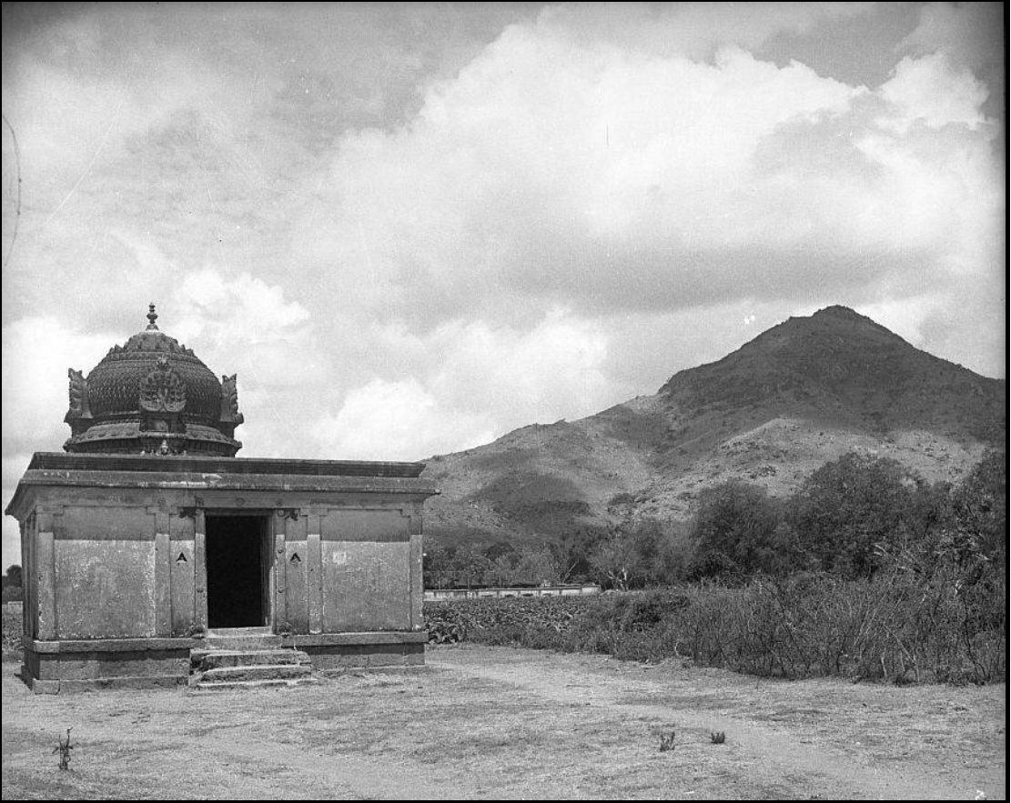
Gurumurtham
Bhagavan stayed 18 months at Gurumurtham

Slide 18
Pazhani Swami
The Bhagavan’s daily routine of life during the year and a half that he stayed at Gurumurtham was rapt samadhi.
Pazhani Swamis duty : Protect the body
not to disturb the Samadhi
feed
Bhagavan just had strength and alertness enough to retain his sitting posture.
On one occasion he found Pazhani Swami holding him with both arms.
“Why do you hold me?” Bhagavan asked reproachfully
“Bhagavan was about to fall, and so I held You and prevented the fall.”
Pazhani Swami politely replied
….. Self Realization

Slide 19
Pazhani Swami
Mango orchard for 6 months
Pazhani Swami brought books “Kaivalya Navaneetam, Vedanta Chudamani,Yoga Vashistam, Prabhulinga Leelai”
Bhagavan wondered “ What is all this? It is already written here in books about myself!”
Arunagirinathar temple; 1-2 months
Bhagavan told Pazhani swami “ lets not live together; live on begging separately”
Pazhani Swami was the shadow of Bhagavan
… Narasimha Swami

Slide 20
Pazhani Swami
Virupaksha cave 1899 to 1916 ; Other attendants came ( Perumal, Ayya, Kanda)
Bhagavan learnt Malayalam to read “ Adhyatma Ramayanam ”
Pazhani Swami’s vow to read a chapter of this book before the meal
Not fluent and took long time to read and others had to wait
Bhagavan requested Pazhani Swami to teach him Malayalam.
Pazhaniswami got his daily dose of Adhyatma Ramayanam and all got to eat in time!
…. Ramana Periya Puranam

Slide 21
Pazhani Swami
Ganesha Stuti (first verse composed by Bhagavan)
statue of Ganesa in a niche inside Virupaksha cave
Pazhani Swami
“ Why don’t you make some offering to Lord Ganesa? ”
Bhagavan
“ Lord with a big and fat belly residing in the niche, you who allowed your father to go around begging, at least now shower your glance of grace on me, who too is the son of that father. ”

Slide 22
Pazhani Swami
Pazhaniswami’s small notebook
Pazhaniswami asked Bhagavan to copy some stanzas of Sankaracharya
Bhagavan collected scraps of paper, stitched them together and wrote selections from around 10 books of Sankara ( 7 X 5 cm size,145 pages)
“The Virupaksha cave had no iron doors then, it had a wooden door with a wooden latch. We used to bolt it from outside with a small stick, go round the hill, wander, return after a week or ten days. This notebook was the only article we took with us. As Pazhaniswami wore a towel, he used to fold the book and tuck it into his waist.. This book was the beginning of our (book) ‘family’”
... Letters Chapter 170(1948)

Slide 23
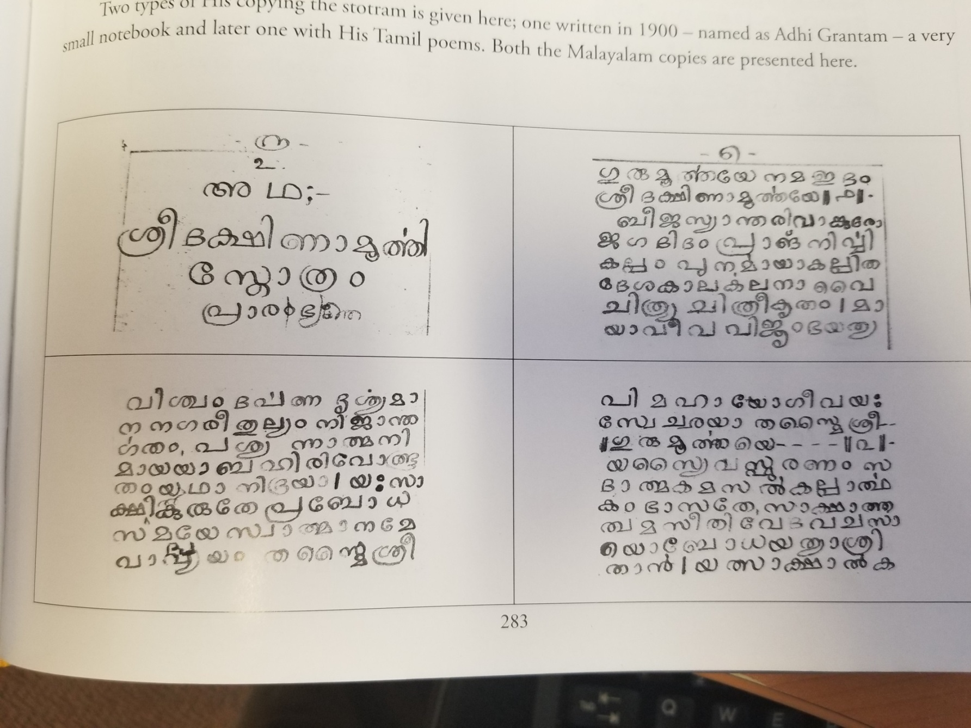

Slide 24
Pazhani Swami
Making of Aksharamanamalai 1914 for begging food
“Samba Sadasiva, Samba Sadasiva,
Samba Sadasiva, Samba Siva”
Completed in one Giri Pradakshina
Bhagavan said Aksharamanamalai fed them for many years.
Centenary in 2014
Comments by Sadhu Natananda and Muruganar

Slide 25
Pazhani Swami; A witness to glorious moments
Kavyakanta Ganapati Muni Intense Tapas 1896 to 1907.
penance in the five holy places(Five elements) of Lord Siva 1904.
“ I am going again to Arunachala, the final destination for one’s search for God. If I do not attain God this time, I am going to proclaim that the Vedas, Upanishads and all the scriptures are just exaggerations of poetic minds ” 1907 Karthigai Deepam time.
Near Nirudhi lingam shrine after 5-6 days of Tapas the divine Mother spoke to him: “ Until you have a Guru, you cannot achieve your goal. Your guru is up there on the hill. Surrender at his holy feet! ”

Slide 26
Pazhani Swami; A witness to glorious moments
9th day of the Kartikai Deepam 1-30 p.m.
“All that has to be read I have read. Even Vedanta Sastra I have studied. I have performed japa to my heart’s content. Yet I have not up to this time understood what tapas is. Hence have I sought refuge at thy feet. Pray enlighten me about the nature of tapas.”
For fifteen minutes the Bhagavan silently gazed at Kavyakanta.
‘If one watches whence the notion of ‘I’ springs, the mind will get absorbed into that. That is tapas. When a mantra is repeated, if attention be directed to the source whence the mantra-sound emanates, the mind will get absorbed in that. That is tapas.”
Kavyakanta ascertained the Swami’s name from Pazhaniswami.
“Ramana”
“Bhagavan Sri Ramana Maharshi”
Part of Kavyakanta’s sloka on Bhagavan
“ To Him praised by Pazhani Swami who has cast off the trammels of birth, to that son of the snake-adorned God(Siva),appearing in the guise of an Ascetic I prostrate! ”

Slide 27
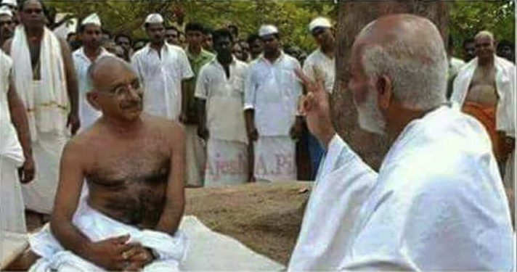
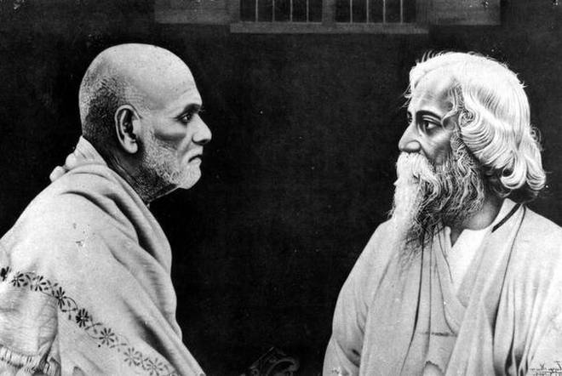
I feel it as the greatest privilege in my life to have a darshan of Venerable sage Sri Narayana Guru.
Sri Narayana Guru (1854-1928)
Social reformer, poet and Saint from Kerala
I have never come across one who is spiritually greater than Sri Narayana Guru

Slide 28
Pazhani Swami: A witness to glorious moments
In 1917 Sri Narayana Guru visited his mutt, at Kancheepuram.
Pazhaniswami met Sri Narayana Guru and requested him to come to the Ashram.
Sri Narayana Guru “Yes, yes. We must certainly go and see the Maharshi. He does not go anywhere. We must go and see him.”
Sri Narayana Guru saw Sri Bhagavan when he was sitting inside Skandashram.
Lunch together
Offering “Nirvritti Panchakam”

Slide 29
Pazhani Swami; A witness to glorious moments
“It’s the only poor me who didn’t have the luck until now”
Farewell : looked intently at Sri Bhagavan for about a minute.
“Bhagavan is Raja Sarpam(King Cobra)”
Municharya Panchakam
“Having been born in Tamil Nadu, if you haven’t seen Sri Bhagavan, you have wasted your life”
In 1928 when Sri Narayana Guru fell ill, Kunju Swami went as per Bhagavan's wish “Are you coming from the Maharshi? Is he all right?”
He took the lime fruit and pressed it against his eyes with great
reverence. Ten days later he attained nirvana.
… .Kunju Swami Reminiscences

Slide 30
Pazhani Swami: witness to glorious moments
Satyamangalam Venkatarama Iyer and Ramana Stuti Panchakam(5 hymns) 1910/11
He came to Virupaksha, and stayed only five days.
Each day he composed a Tamil song in praise of Sri Bhagavan
Narasimhaswami visited Satyamangalam, to collect more particulars about him.
Satyamangalam means Abode of Blessedness. Bhagavan’s comment
Ponnolir pattu verse 1
“Ponnolir vadivinane purana vadanattane
Tannarun swanubhuti dharayellam manakka yezhai
Unnarun pughazhai kettiv Ulagellam tedi vanden
Ennarul iraaiye Jnana Ramanare jyotikundre”
Of Gold bright form, the lotus faced one! Your rare realization spreads fragrance all over earth! Having heard your fame, poor as I am, I looked for you throughout the world and reached You here; My Gracious Lord! Wise Ramana! Hill of Light!!

Slide 31
Pazhani Swami
1916 Bhagavan moved to Skandashram.
11th June 1918
Bhagavan saw a peacock flying up to Skandashram in great excitement. He went down to the Cave. Pazhani Swami was gasping for breath. Bhagavan put his head on lap with one hand on head and other on chest. Bhagavan took his hand off and Pazhani Swami’s eyes opened.
“That is said to be the sign of one going to higher states of spiritual experience, though not the sign of immediate merger at the Heart.”
Bhagavan attending last moments…Sri Rama attending Jatayu
Described as Nandi of Bhagavan by Kunju Swami and Viswanatha Swami
First one and one among the only 3 blessed souls

Slide 32
Ayya Swami

Slide 33
Ayya Swami
Ayya swami, who was from Kerala, began his service of the Maharshi (1910+) at around 25 years of age
His devotion and service-mindedness, detachment, selflessness were unequalled.
He was loyal to Pazhani Swami.
Never wasted time and quietly go out into the town begging.
Craftsmanship that got Bhagavan’s appreciation
Kamandala, walking sticks, begging bowls, cups from coconut shell
small cups to keep Vibhuti and Kumkum from Bilva fruit
“He could manage even ten Ashrams at a time” said Bhagavan.

Slide 34
Ayya Swami
Ayya Swami intuitively knew what Bhagavan wanted.
Ayyaswami, ‘Bhagavan, how could I know? it merely occurred to me that I should take a particular article to Bhagavan. I brought it and that is all. You say that you were thinking of the very same article at the time. Bhagavan alone should know about such strange happenings.’
Bhagavan “Really, he used to keep his mind pure, and so whatever we thought about here used to mirror itself in his mind.”
….. Letters Chapter 55
Ayya swami passed away quite young, in 1920s.

Slide 35
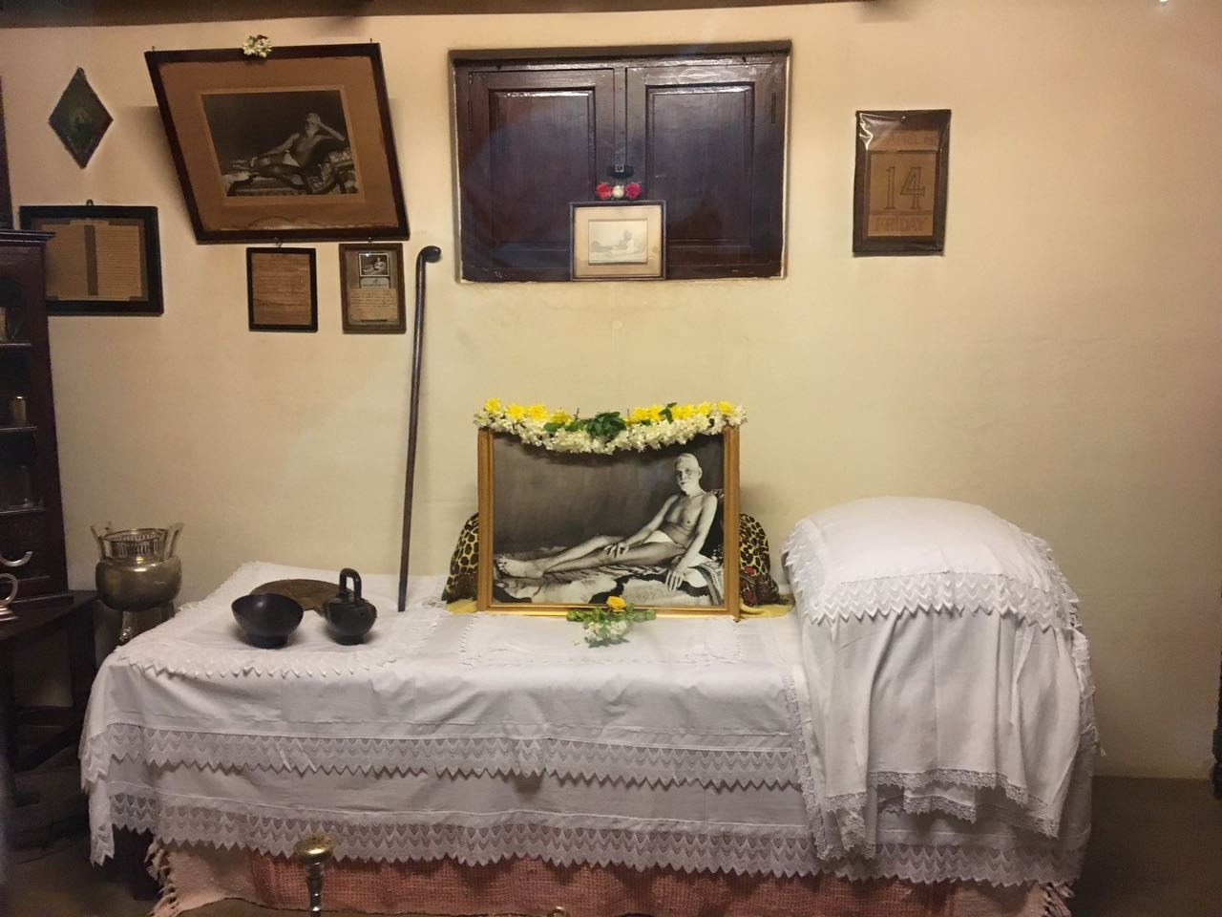

Slide 36
Kunju Swami and Ramakrishna Swami
“ Nokkiye karuthi meythakkiye pakkvam
Aakkinee aandu arul Arunachala! ”
... Akshara manamalai verse 63
O Arunachala, may You graciously take me as Your own, having made me mature by seeing me, thinking of me and touching me.

Slide 37
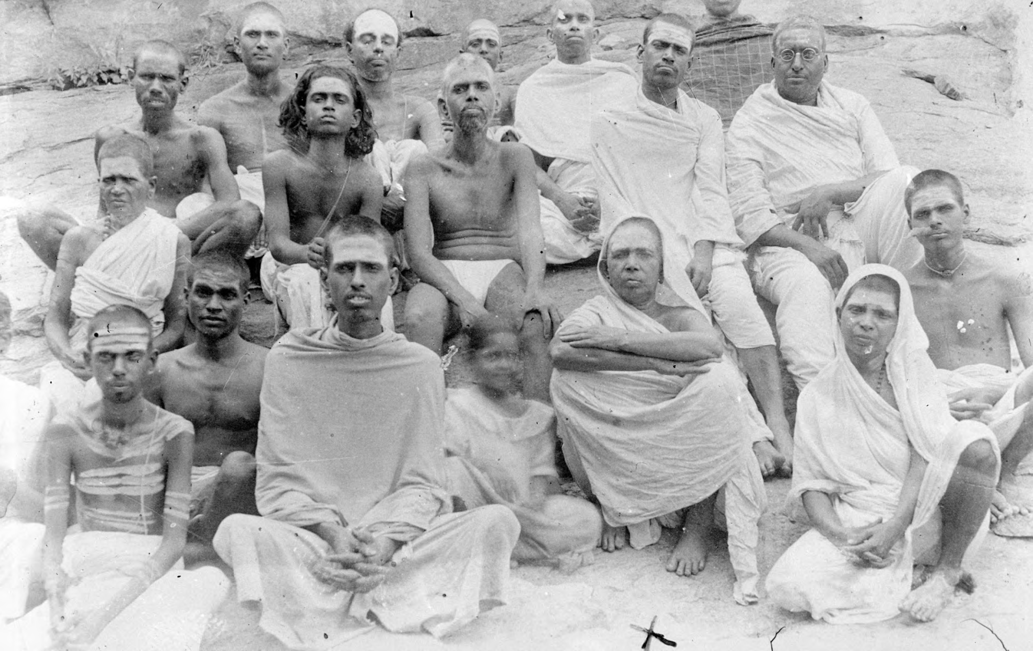

Slide 38
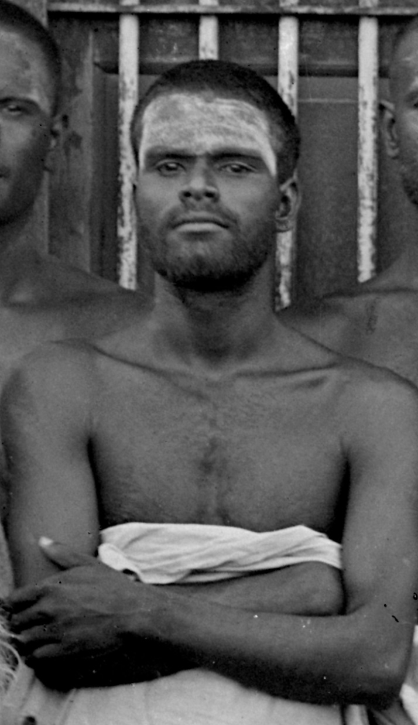
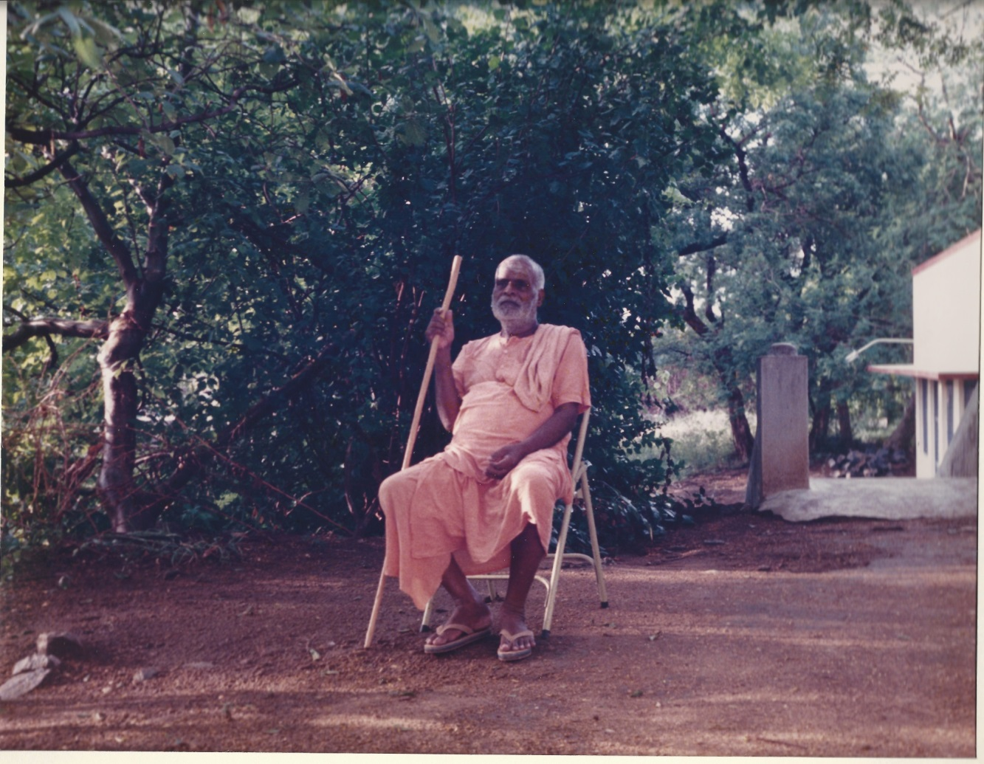
Kunju Swami

Slide 39
Kunju Swami
Born in 1897 Cherakkodu to pious parents.
3rd year horoscope ‘divine child”
7th year saw and wished to recite mantra
Lord Siva came in dream and whispered Panchakshara Namasivaya in ear 3 times.
Forgot and Lord Siva came again in dream next day.

Slide 40
Kunju Swami
“In the ancient Vedic period there were many maharshis who with just one look gave an experience of the Self. Are there not any such now?”
Kuppandi Swami(Kunju’s initial Guru) had seen Bhagavan
“ When I heard the name Ramana Maharshi, I enjoyed a bliss
I had not experienced before. I felt like flying to Thiru”
Ramakrishna Swami was a neighbor and Kunju Swami advised him to go to Bhagavan.
Ramakrishna sent a picture and Kunju Swami felt again peace and bliss.

Slide 41
Kunju Swami
Came to Bhagavan 1920
Mudaliar Patti directed him to Bhagavan
Bhagavan at Skandashram with mother, Nirnjananda Swami, Ramakrisha Swami.
The day Annamalai Swami died of plague. Bhagavan consoled Mother
“ Why are you weeping? You are weeping because you lost one son, but another son has come now ”
Echammal served first food.
Gurus initial Upadesha
Catch the four; Release them one by one; Clean it
“Prajnanam Brahma” Consciousness is Brahman
“Aham Brahmasmi” Brahman am I
“Tat Tvam Asi” That You are
“Ayam Atma Brahma” I am the awareness individual and cosmic.

Slide 42
Kunju Swami
Kunju “what should I do to get mental peace?”
Bhagavan “You have read Kaivalyam. if you realize yourself, you will be freed from all trouble.”
Kunju “How to realize the Self?”
Bhagavan “You should first know who you are”
Kunju “How I could find out who I am?”
Bhagavan “Find out where thoughts start from.”
Kunju “How I should do it?”
Bhagavan “Turn inward and merge the mind in the heart.”
“After saying this, Bhagavan fell into Silence. Thinking I should also be like him, I sat in silence. Sri Bhagavan’s gracious looks were on me. My mental agitation vanished that very moment.”

Slide 43
Kunju Swami
Importance of proximity of Bhagavan
Mothers Samadhi
3 kinds of japa: Uccha, Upamsa and Manasika
Significance of true Namaskar
Visit to Mahadeva Swami at Kovilur Mutt
“ What an intelligent, wise fellow! Is your Bhagavan only within this body? Is he not elsewhere? If a person is devoted wholly to one Guru, he should not go anywhere. If you go to another place, you must do what the people in that place do. Wherever and whenever you prostrate, you should think of your Guru. If you do like this, your namaskar will reach the person you have in mind. ”

Slide 44
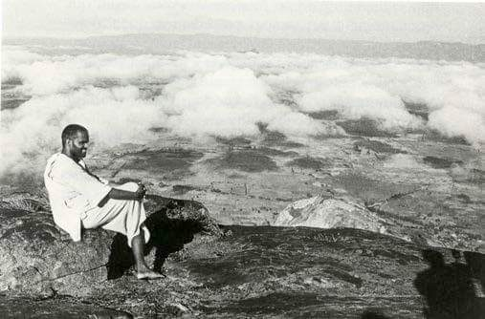
Pranks and Vows
Girivalam 2-3 times a day, fasting, sleeping on bare floor.
Not to sleep for 8 days continuously drinking only Tea.

Slide 45
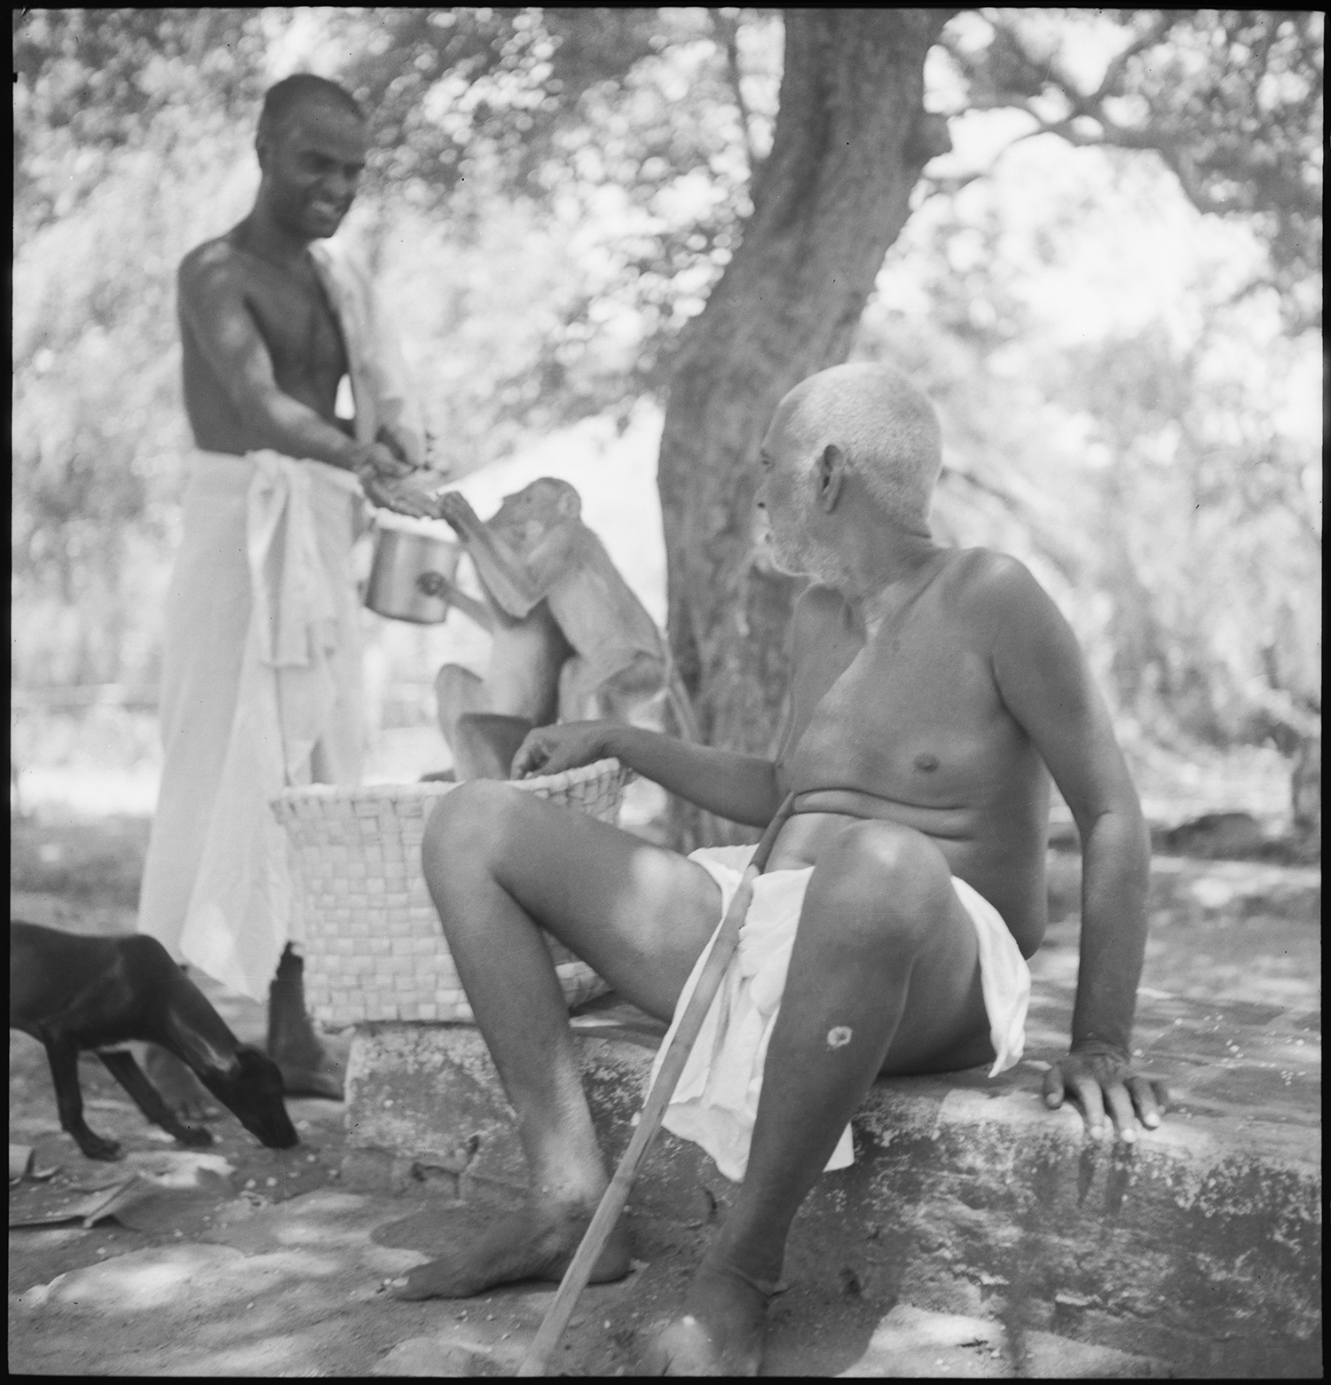

Slide 46
Kunju Swami
There is nothing better than giripradakshina. That alone is enough. If you do japa or meditation sitting in one place, the mind may wander. But during giripradakshina, the limbs move but the mind will be still. Doing japa or meditation without any other thought while walking is called “samadhi in movement”
medicinal herbs on the hill; their breeze will be good for health.
There are several siddhas and sages on the hill even now. They also go round the hill unseen by us. While during pradakshina we should walk on the left side of the road, otherwise we shall be obstructing their movement. We will also have the benefit of walking around them.”
Kunju Swami about accompanying Bhagavan on giripradakshina
“We did not feel that we were walking with one of our friends or even a saint, but with the supreme God himself”

Slide 47
Kunju Swami
Ramakrishna swami’s younger brother, Vasudevan was studying in a high school.
A sadhu initiated him into certain spiritual practices.
His intense concentration state of delirium.
Kunju Swami planned to go and help him
Ramakrishna swami had just enough money to buy my ticket.
How Bhagavan arranged food for Kunju’s travel
“He has no money to buy food on the way.”
Incidents where Bhagavan deviated from his principles for his devotees

Slide 48
Kunju Swami
Retirement to continue Sadhana 1932
Bhagavan “ It is no use saying I am serving Sri Bhagavan, and I am dusting his bed etc. The greatest service to the Guru is to be engaged in Self-enquiry and meditation in all sincerity. ”
Upadesha

Slide 49
Kunju Swami
Both morning and evening, I would go and sit before Sri Bhagavan.
Tamil parayana. How Kunju Swami made sure that Bhagavan talked to him everyday.
Bhagavan’s handwriting in Kunjus note book.
Kunju Swami wanted to paste a picture of Arunachala in the notebook. Bhagavan came to know of this and drew a picture of Arunachala. It is this picture that appears in the Mountain Path

Slide 50
Kunju Swami
difficult problems concerning the Ashram management.
Kunju Swami worried about the reputation of Ashram
Kunju Swami just entered the old hall while other devotees were discussing this problem.
Bhagavan turned to Kunju
“why did you come in at this time? why you are getting engaged in such matters?”
“what is your original purpose of coming to Bhagavan?”
Kunju, “To receive Bhagavan’s Grace.”
Bhagavan “Then occupy yourself with that only.”
….Maharshi Newsletter 2017

Slide 51
Kunju Swami-Darlene conversations
With Kunju Swami every talk was so natural and spontaneous even though we needed a translator. His joy and reverence for Bhagavan always came through. He often marveled at us “ foreigners” who never saw Bhagavan but were drawn by love to Him. He said we were like the honeybee, who went straight to the nectar.
Life was absolutely spontaneous. Bhagavan's instruction was
“Go to sleep when the body requires it. When awake, engage yourself in sadhana. Do not even think whether it is day or night. Do not doze off pretending to do meditation. Be sincere and whole hearted in sadhana as well as sleep”
….Mountain Path 1979

Slide 52
Kunju Swami-Darlene conversations
Kunju “If thoughts arise while doing Pradakshina,
what are we to do?”
Bhagavan “ Just do nothing. Ignore them. Keep yourself away
from them, as you automatically do when a donkey or dog
crosses you while walking around the hill. If you ignore them,
they will get away of their own accord”
Darlene’s comment
….Mountain Path 1979

Slide 53
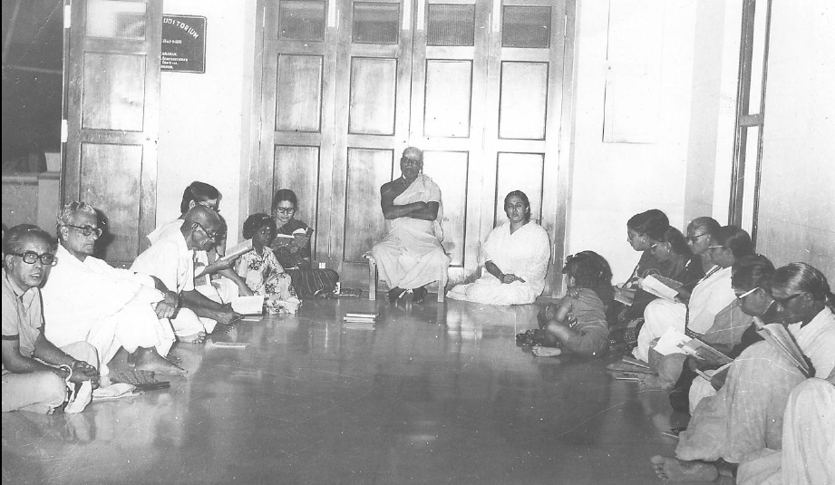
Lead role in establishing
Tamil Parayana at Ashram

Slide 54
Kunju Swami
Last days at Ashram
When admirers invited him to visit their native places, he squarely rejected them all, saying, "I have taken marana sannyasa”
Never complained about anything
On his last night, he asked his attendants to help him sit in padmasana. “I am going to meditate,” he declared. He remained in deep meditation while his attendants slept. After two hours, when they awoke and touched him, his body was cold. He had passed away in that silence. Samadhi shrine at Ashram compound
7 August 1992 at 96 Years; 70 years at Ramanashramam

Slide 55
Kunju Swami

Slide 56
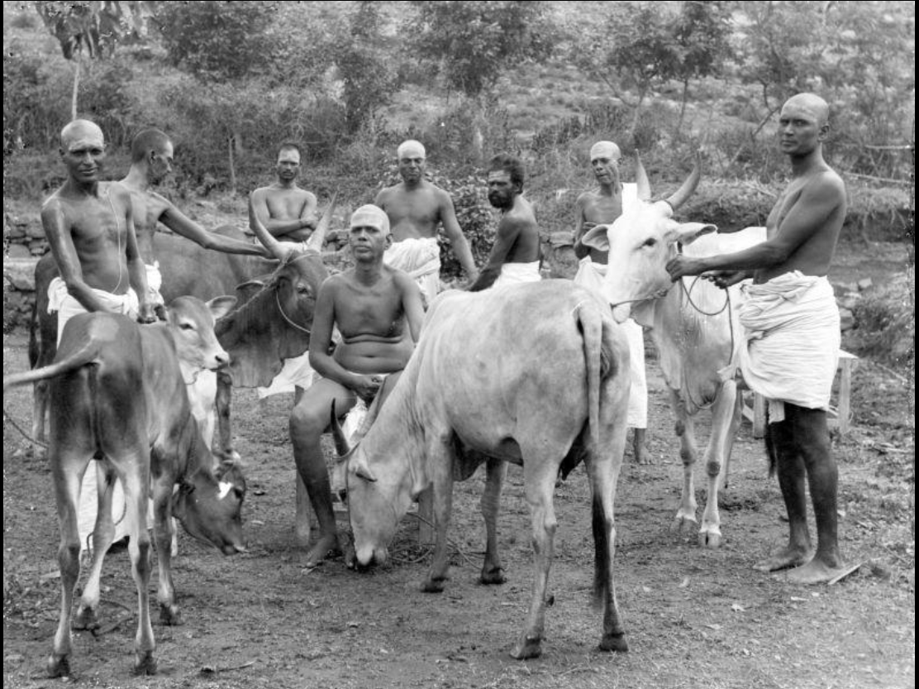
Ramakrishna Swami

Slide 57
Ramakrishna Swami
Came to Bhagavan just before Kunju Swami
Served Ashram in stores and gardens .
Present at Mother’s Samadhi and carried the sacred body down to Samadhi site
Used to have epilepsy since childhood and had one while at Ashram
Bhagavan enquired, “Hey, Ramakrishna! How did you feel?”
Ramakrishna “Bhagavan, I lost consciousness of the body and the surroundings. I knew nothing.”
Bhagavan “No, no; it should not be like that. You should hold on to the inner awareness all the time. Even if you lose outward consciousness, you should never let go of inward awareness.”

Slide 58
Ramakrishna Swami
Robbers incident at Ramanashramam 1924
Kunju began to use threats and tried to go out to face the thieves.
Bhagavan “Let these thieves play their Dharma; we shall stick to ours. Let them do what they like; it is for us to bear and forbear. Let us not interfere with them”
Ramakrishna asked the thieves not to create unnecessary trouble.
Bhagavan wanted to make sure the sickly dog Karuppan ‘s safety.
Bhagavan received a blow on his left thigh, and at once said,
“If you are not satisfied yet, you may strike the other leg also.”
Bhagavan “received adequate pooja”
Consoled Ramakrishna
“If you go and strike them some may die. That will be a matter for which the world will justly blame not the thieves, but us. These are only misguided men. But let us note what is right and stick to it. Sometimes your teeth suddenly bite your own tongue; do you knock them out in consequence?”

Slide 59
Ramakrishna Swami
Ramakrishnaswami decided to do tapas at Virupaksha Cave.
4th day he had a visions. He could see kumbakonam and Ramanashramam there. He was delighted that Arunachala gave him whatever he wanted, so soon.
He returned to the Ashram and narrated his thrilling experience.
All were wonder-struck .
Bhagavan
“Oh! Is this tapas? Seeing kumbakonam, seeing the Ashram? Tapas means being in the Self and not saying, ‘I saw this, I did this.’ These are fleeting things.”
Guhai Namasivaya and disciple similar incident.

Slide 60
Madhava Swami
Vittidil kashtamam vittidadu unai
Uyir vittida arulpuri Arunachala
.. Akshara manamalai verse 96
O Arunachala! If You leave me, it will be a terrible affliction for me. Hence bestow Your Grace upon me so that my life may leave the body without my leaving You.

Slide 61
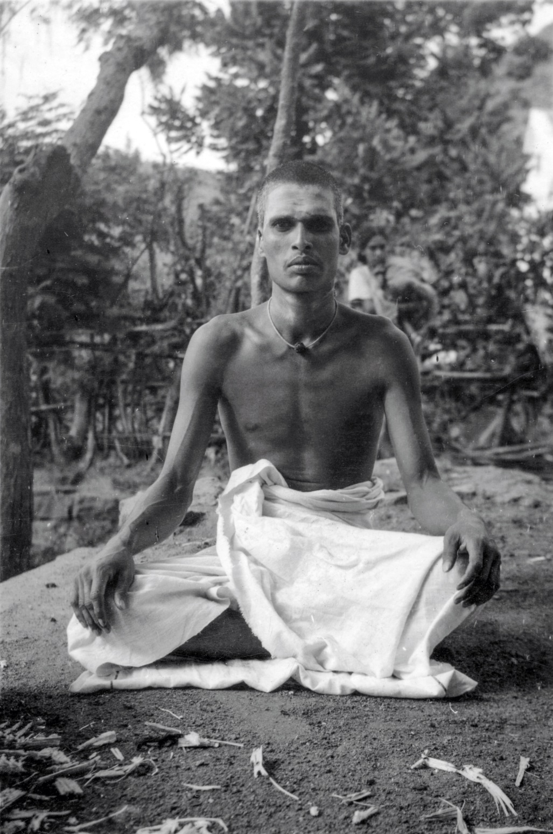
Born in Palakkadu
Kunju Swami met him at an Ashram in Malabar and got him to Ramanashramam
1932 when he was 20 years of age

Slide 62
Madhava Swami
Madhava Swami was binding a book, a devotee asked Bhagavan if he could borrow a book from the library.
Bhagavan asked Madhava Swami to get it saying,
“You do my work and I will do yours.”
Devotee commented
“My work means looking after the needs that arise in the minds of
devotees or anything from Bhagavan.
Your work is to get liberation, which is not possible without Bhagavan’s grace and help.”
Bhagavan heard this comment and agreed
‘Hum! Hum! That is what it is.’

Slide 63
Madhava Swami
Madhava Swami volunteered to look after the little deer “Valli”
She grew up as an Ashram pet. Bhagavan regularly fed her.
Valli attained Samadhi by Bhagavan's Grace and has a Tomb in Ashram
Madhava Swami showed Bhagavan the nearly dead Crow in front of the Ashram
Bhagavan blessed by pouring water on the crow
Tomb in the Ashram

Slide 64
Madhava Swami
Ramaswamy Iyengar(Acharya Swami)of Kumbakonam passed away at Ramanashramam. Madhava went there as head of the Math and passed away within a short time. 1946 10 July (~35 years)
Kunjuswami had gone to supervise burial ceremonies
Bhagavan
“Madhava was a good man. That is why we all feel sorry that he is dead.
A jnani always looks forward to the time when he will be free from the bondage of the body and be able to throw it away. A person who carried a load for a wage always longs for the time when he could reach the destination so as to put it down. This body is a burden to a man of discrimination.
When life is in, the body is no burden; but when that little thing called life is gone, there is nothing so burdensome as the body. Four people are needed to carry it.
There is no one who can remain in this body forever. Once a person knows the true state, who wants this temporary body?”
….Letters and Day by Day

Slide 65
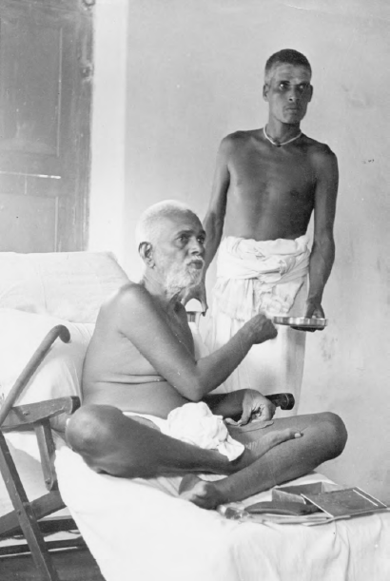
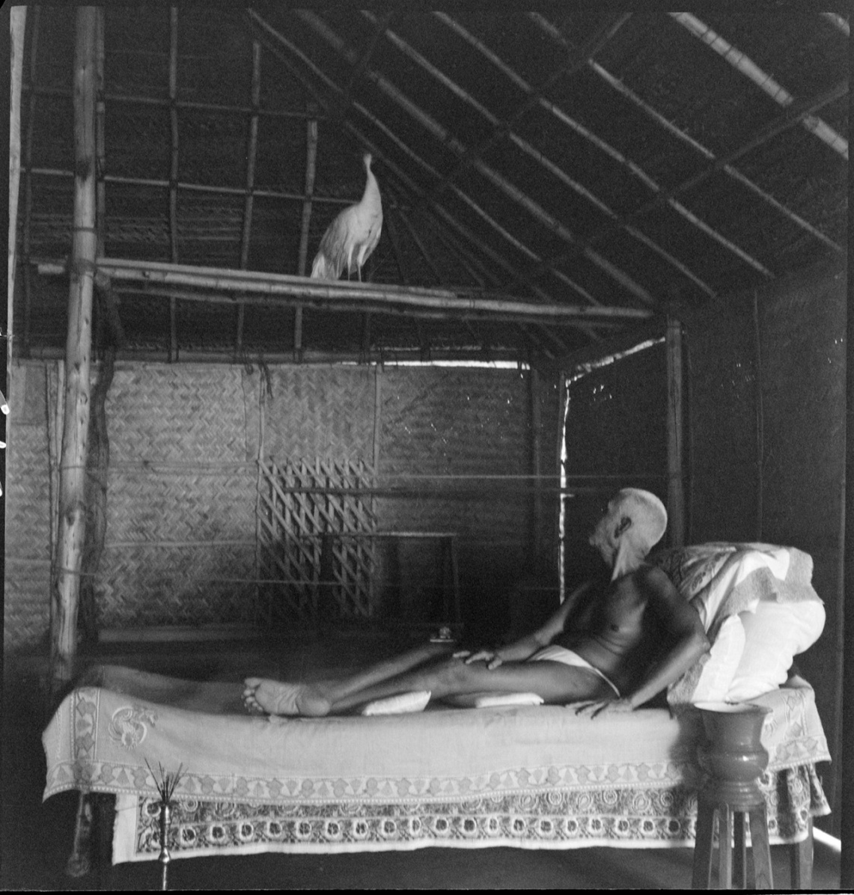

Slide 66
Madhava Swami
The Rani of Baroda gave Bhagavan a white peacock.
Bhagavan would nurse this peacock and pick lice off its body.
He taught it to be a strict vegetarian.
“Building supervisor” as he daily visit temple construction and
“ Assistant Sarvadhikari” as he supervise meals.
June 1947 “Mayura Vrittam” by SubbaRamayya.
Lalita Venkataraman was asked to sing with Veena
Bhagavan “But the hero must be present to hear his praises!
where are you Madhava? Come!”
Peacock came flying and danced to the song.

Slide 67
Satyananda Swami
Solladu solli nee sollara nillendru
Summa irundai Arunachala!
…. Akshara manamalai verse 36
O Arunachala! Saying in Silence “Be without speech” You remained Still.

Slide 68
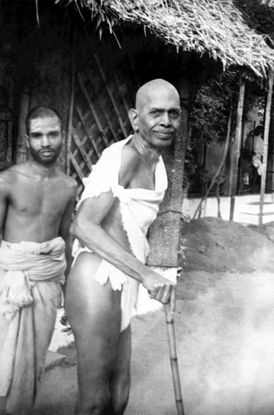
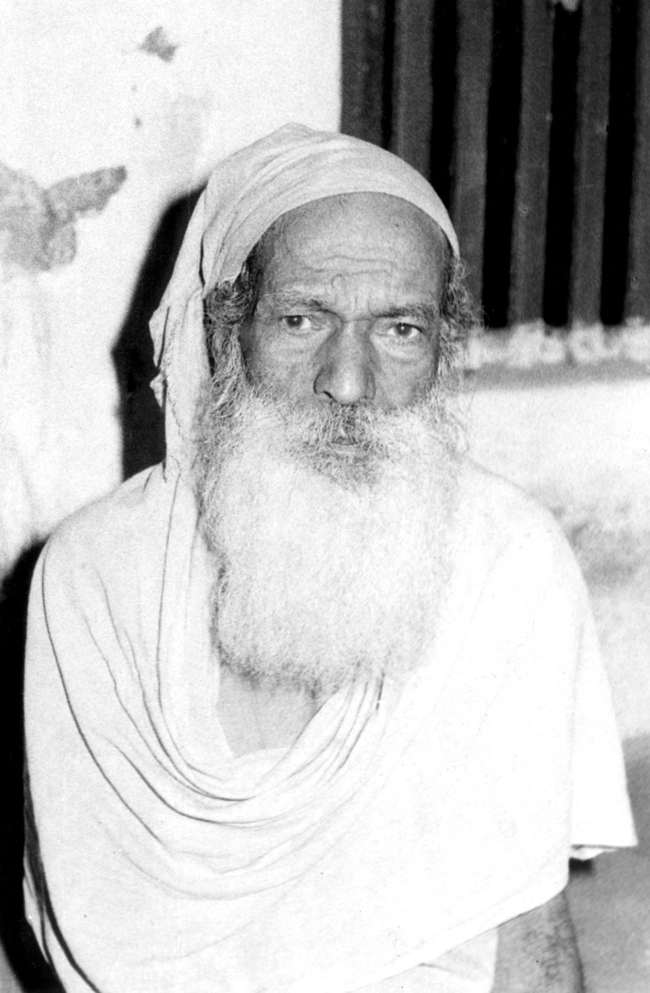

Slide 69
Satyananda Swami
Born 1916 Alappuzha, Kerala
Heard about Bhagavan on pilgrimmage to Rameshwaram and came in 1938… attendant since 1946.
“Bhagavan looked at us and smiled. I can never forget that smile”..
2 most powerful languages Bhagavan had: Gaze and Smile
Bhagavan called him Satya
Sweet, soft-spoken, simple at heart and in dress, innocent, reticent and receptive, methodical and mindful in his work. Kept his heart fully open for Bhagavan to pour His boundless love.
…Mountain path May-June 1989

Slide 70
Satyananda Swami
One day Sri Bhagavan narrated and acted to Satya how one Sadguru Swami from Kerala behaved..
“You are a good boy. It is a pleasure to see you”.
Satya was alone with Bhagavan at the time and still remember the scene with joy.
After one operation there was profuse bleeding from the body of Bhagavan. Satyananda was very moved and, shedding tears, told Bhagavan that it was painful to see such suffering. Bhagavan was absolutely unconcerned
“What suffering? All is Bliss.”

Slide 71
Satyananda Swami
Satya was blessed to be near Bhagavan during the Maha Nirvana.
At 6 pm He massaged Bhagavan’s legs.
At 6.30pm Bhagavan wished to sit upright. Then the chanting of Aksharamanamalai was started. There were profuse tears from Bhagavan, though there was no change in the expression on his face. It was such an immense outflow that Dr. T.N. Krishnaswami asked Satya to wipe the tears away. He did so, but tears would not stop. This continued till 8 p.m.
Satya gave a little water and fruit juice to Bhagavan with a spoon.
“The most awe-inspiring moment was the physical demise of Bhagavan. There was no physical movement of any kind, no visible change, not even a flutter. It was as if the human frame in which Bhagavan was, turned into a statue instantaneously.”

Slide 72
Satyananda Swami
13 years observed silence since Bhagavans Nirvana
Took care of Nirvana room and library
“Has anyone fed the peacock yet?”
“Pori”(puffed corn) Swami as he fed the peacocks
Lived in Palakkottu until 1989 Nov 27

Slide 73
Role in literary works of Bhagavan
Pazhani Swami
Akshara manamalai
translated to Tamil: Dakshinamurthy Stotram, Hastamalakam, Guru Stuti
Ayya Swami
Arunachala Ashtakam and Patigam
Translated Arunachala Pancharatnam to Tamil
translated some parts of Sankara Vijayam to Malayalam.
By 1917 Arunachala Stuti Panchakam completed
Kunju Swami and Ramakrishna Swami
Upadesha Saram to Malayalam
Madhava Swami
Sad Darshanam to Malayalam

Slide 74
Contributions of attendants from Kerala
Made sure Bhagavan’s physical presence for more than 5 decades.
Requested Bhagavan to interpret/translate and write many literary works that we cherish today.
Lived by his teachings and set an example.
Remained as guides and treasure troves for future devotees.

Slide 75
Kunju Swami
Upadesha to Kunju Swami in 1932
“Make Self Enquiry your final aim, but also practice meditation, japa and parayana. Practice them relentlessly. If you tire of meditation, take to japa, if you tire of japa, take to Self Enquiry, if you tire of that, do the parayana. Do not have a gap between them. Do not allow the mind to sway. Practice this faithfully, and in the end you will be established in Self Enquiry and find culmination in Self realization.”
“Why? It is very easy. Before you go to sleep, meditate and go into the Self. Then when you fall asleep, your whole sleep will be a meditation of staying in the Self. The moment you wake up in the morning, again go into meditation for a few minutes and remain as the Self. Throughout the waking state, the undercurrent of remaining in the Self will be there even though you are working, or arguing. This substratum will always keep you in the Self.”

Slide 76
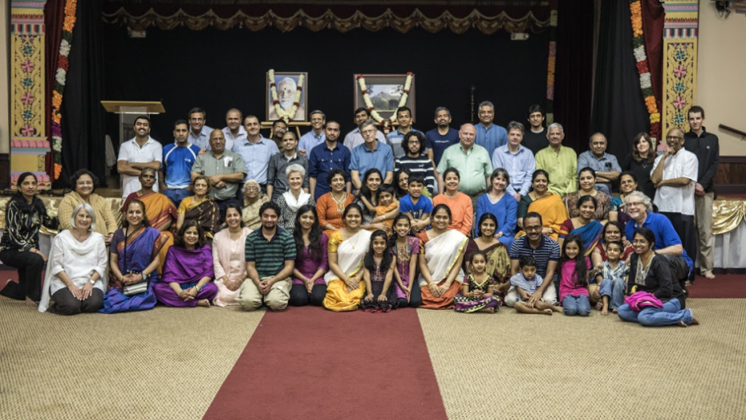
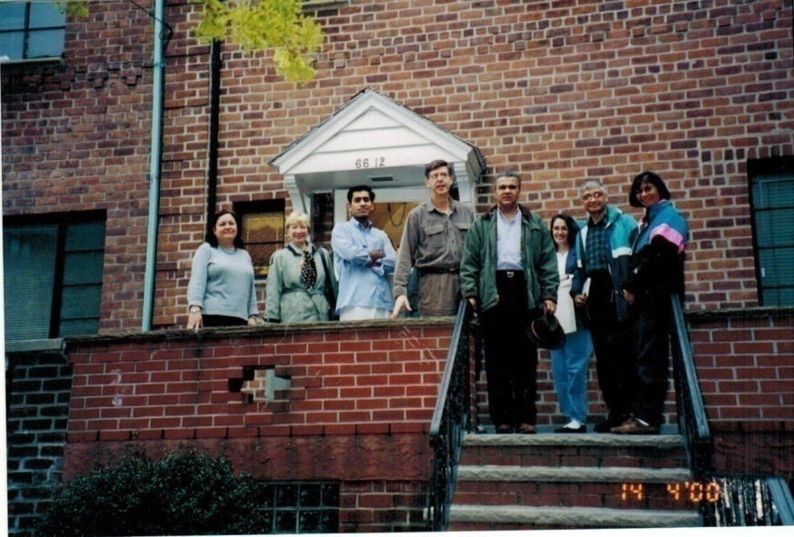
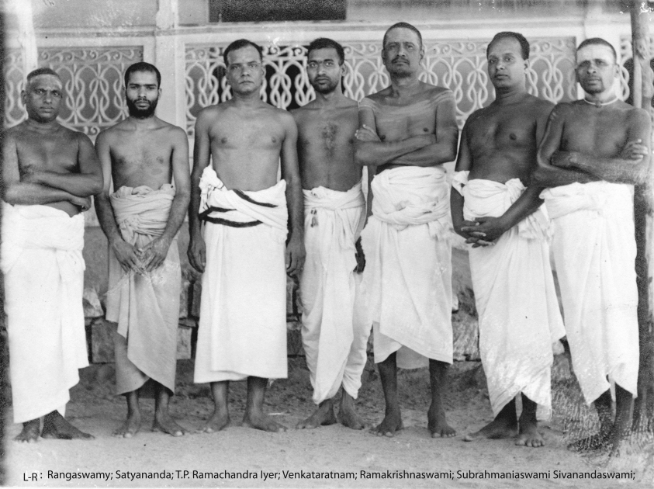
O Arunachala! Bestow Your Grace so that I may graciously become a devotee of the devotes of the devotees

Slide 77
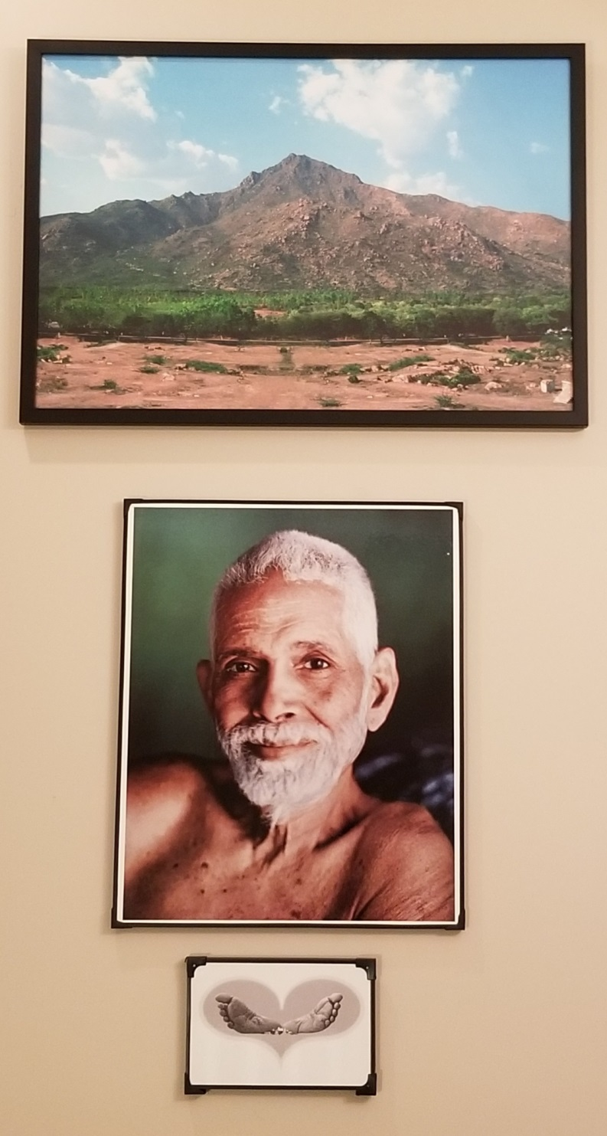
Sarvam Sri Ramanarpanamasthu

Slide 78
Aksharamanamalai
Tradition has it that Saint Māṇikkavāchakar, pointing to Lord Nataraja enshrined at the ‘sanctum sanctorum’ of The Temple Chidambaram as the ‘meaning’ of his monumental work Tiruvāchakam dissolved into the Effulgence therein and shone as “That”. It is certain beyond doubt that if Bhagavan Sri Ramana were to be asked the content of Arunachala Akshara Mana Malai that he had bestowed, he also would have looked at Arunachala in Perfect Silence and would have shone, indeed, as Arunachala Himself.
….Sadhu Natanananda
Akshara Mana Malai, The Marital Garland of Letters is but the delectable outcome of the mystic experience of ‘Parabhakti’. This Supreme Love welled up unbounded in all its sharp exceedingly acute and burning intensity towards the bridegroom Arunachala in the heart of Bhagavan wherein, sunk deep, he had subsided with a highly subtle mind with profound fortitude. This Text of fragrant verses – the foremost of Adhyatmic Texts bestowed by Bhagavan – with its expansive sweep, fathomless depth and rare
grandeur is not easy of discernment even for scholars of great erudition.
…..Muruganar

Slide 79
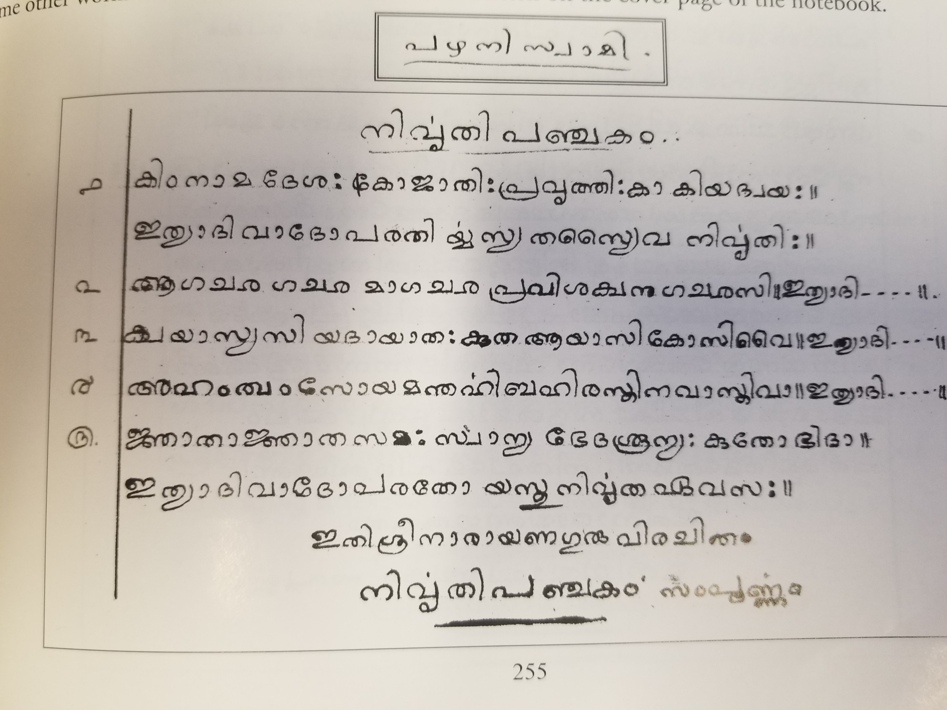

Slide 80
Nivritti Panchakam
“He alone enjoys the Inner felicity of the One Self of all, who refrains from enquiries about the name, native land, caste or clan and age of others.
He alone enjoys the inner felicity of the One Self of all, who remains the same with the known and unknown and free from distinctions as oneself and others and the assertion of even of non-difference”

Slide 81
Pazhani Swami
Pazhaniswami used to wear only a towel reaching to his knees. He had only two towels.
All the vessels he used were earthen vessels. The number of visitors increased at Virupaksha. When visitors asked for water, it was served in an earthen mug.
But he refused to accept their suggestion and offers.
He never accepted anything from others, and without fear or favour, he acted in a straightforward way. He spurned everything in the world except service to Sri Bhagavan.

Slide 82
Pazhani Swami; A witness to glorious moments
Pavazhakundru 6 months; Mother came to meet first time 1898
Reply to Mother
“The Ordainer controls the fate of souls in accordance with their past deeds, their prarabdha karma. Whatever is destined not to happen will not happen, try how hard you may. Whatever is destined to happen will happen, do what you may to stop it. This is certain. The best course, therefore, is for one to be resigned.”

Slide 83
Pazhani Swami: A witness to second death experience
Bhagavan sometimes moved about in a state of trance. This ended in 1912 with another complete experience of death. He set out from Virupaksha Cave one morning for Pachaiamman Koil, accompanied by Pazhaniswami, Vasudeva Sastri and others. was nearing Tortoise Rock on the way back.
“ The landscape in front of me disappeared as a bright white curtain was drawn across my vision and shut it out. I could distinctly see the gradual process. There was a stage when I could still see a part of the landscape clearly while the rest was covered by the advancing curtain. It was just like drawing a slide across one’s view in a stereoscope. On experiencing this I stopped walking lest I should fall. When it cleared I walked on. When darkness and faintness came over me a second time I leaned against a rock until it cleared. The third time it happened I felt it safer to sit, so I sat down near the rock. Then the bright white curtain completely shut off my vision, my head was swimming and my circulation and breathing stopped. The skin turned a livid blue. It was the regular death hue and it got darker and darker. Vasudeva Sastri, in fact, took me to be dead and held me in his arms and began to weep aloud and lament my death. I could distinctly feel his clasp and his shivering and hear his words of lamentation and understand their meaning. I also saw the discoloration of my skin and felt the stoppage of my circulation and breathing and the increased chilliness of the extremities of my body. My usual current of awareness still continued in that state also. I was not in the least afraid and felt no sadness at the condition of the body. I had sat down near the rock in my usual posture and closed my eyes and was not leaning against the rock. The body, left without circulation or respiration, still maintained that position. This state continued for some ten or fifteen minutes. Then a shock passed suddenly through the body and circulation revived with enormous force, and breathing also, and the body perspired from every pore. The colour of life reappeared on the skin. I then opened my eyes and got up and said, ‘Let’s go’. We reached Virupaksha Cave without further trouble. This was the only fit I had in which both circulation and respiration stopped. ”
Later he added: “I did not bring on the fit purposely. It was one of those fits that I used to get occasionally, only this time it took a very serious form.”
….Ramana Maharshi and Path of Self Knowledge

Slide 84
Pazhani Swami
Hatha Yogi Schindananda Yogeswara
Disciple said “He is in Samadhi now. He will wake up at particular time and give his talk. When is your Bhagavan in Samadhi?”
Pazhani Swami burst out laughing
Kunju Swami explained “For a jnani, there is no specific time for being awake or in samadhi. He (Pazhaniswami) was amused at your question.”

Slide 85
Pazhani Swami
“ A person may be in padmasana but if he does not enjoy Bliss, he cannot be said to be in samadhi. The greatest samadhi is to throw desire into the fire of Self-realisation. To be outwardly quiet without inward peace is not samadhi. ”….. Yoga Vasishtam
“ A man who is asleep in a cart is hardly aware of the movement of the cart, its stopping or the unyoking of the bullocks. So does a jnani sleep in the body. He is hardly aware of work, samadhi and sleep. They are all the same to him. ”
…. verse 31 “Forty Verses on Reality, Supplement”

Slide 86
Ayya Swami
bowl and the kamandala which were regularly used by Bhagavan
(now in nirvana room).
make and gift to others walking sticks, kamandalas and begging bowls.
To make a walking stick, he would measure a stick, remove the bark with a knife, smooth the surface, and later rub it with sandpaper and a leaf called guttipura. Then he would apply oil to it and polish it with a woollen cloth. The stick used to shine beautifully. Bhagavan later used to ask the attendants to make walking sticks in a similar manner.
used to remove the kernel of the bilva fruit, clean it, plug the holes with small pieces of wood and use it for keeping vibhuti or kumkum. He would make nice cups out of coconut shells.

Slide 87
Kunju Swami
Most people stutter and stammer in the presence of Sri Bhagavan. I never. Like a person in the presence of a benevolent mother, I used to feel happy and enthusiastic while reading verses or discussing spiritual matters in his presence.
Initial Guru’s visit to Bhagavan
Giri Pradakshina consecutive 48 days
Showed Bhagavan his Tamil notes on Vedanta
“ This boy’s father is a good man. He entrusted him to me hoping that he would be a Vedantin. I taught him Vedanta for some time. I could not continue it as I had to go on a pilgrimage. He has come to you because of the good deeds he had done in his previous birth. Hereafter you are his refuge. Please look after him. ”
Read Mountain Path Article 1974

Slide 88
Kunju Swami
Narayana Swami taught 4 ways one should serve my Guru from “Vedanta Chudamani”
Apta. understanding duties from a study of the sastras, tries to perform them to the satisfaction of the Guru.
Angam is when a disciple looks to the physical comforts of his Guru.
Danam is when he looks after the trees, plants and creepers in the Ashram the way householders look after their property.
Sadbhava is looking on everything as one’s Guru.”
attending on the Guru in this fashion, one would realise the Self without the aid of anything else.

Slide 89
Kunju Swami
Wanted Vibhuti bag; Lord Siva came in dream again and showed a place where he can get money to buy it
8 years wanted Rudraksha Mala
On the road!! Unusually large lotus flower and mala inside.
10 year could explain the spiritual discourse he heard to his mother.
Started giving discourses.

Slide 90
Kunju Swami
18 years started learning Vedanta from Ellapalli Kuppandi Swami Kaivalya Navaneetham and Vasishtam
15 days memorized 100 verses
Pudupalayam swami Gounder(Rangaswami Gounder) :You must practice what you learn.
Kunju Swami yearned for Samadhi which never happened.
Kuppandi Swami planned on giving up his body and wanted Kunju Swami to take over his Mutt.

Slide 91
Kunju Swami
Jan 1920 started off to Bhagavan
5 rupees given by father
Kanjikode to Katpadi and then to Thirukoilur
No train stop at Thiru because of Plague. Shortage of money and how he got it
He has to jump off the train at Thiru with a fellow passenger at 9pm
Stayed at a Mantapam and went to Bhagavan next day early morning

Slide 92
Kunju Swami
Never seen Bhagavan sleeping fully stretched out nor on one side. Always found reclining on a pillow
Frugality was an Art…food, tooth powder, oil
Floating on water in Padmasana pose
Eating Greens as main dish and rice as side dish
Once in 2-3 days in Skandashram and once in a week at Ramanashramam during Aksharamana malai chanting Bhagavan will go into deep meditation. Blow conch to wake up

Slide 93
Kunju Swami
“Aspirants in the spiritual field experience power and peace. When the Buddha secured power after doing tapas, he established his religion. Adi Sankara’s wanderings, writing of the Brahma Sutra Bhashya and establishing the mutts were the outcome of this power. It was this power that propelled Swami Vivekananda to Chicago, and made Mirabai, Tukaram and Chaitanya forget themselves in their song and dance. But Sri Bhagavan was above all these people. He did not exhibit his power nor expend it. He was like the great Lord who had swallowed a mountain!
Sri Bhagavan got merged in that still, unchanging Self. Controlling everything, he was peace personified. Sahaja Samadhi was his natural state.”
….Kavyakanta about Bhagavan

Slide 94
Kunju Swami
Bhagavan’s Sahaja Samadhi
Music performance at Ashram.
“I knew their coming, prostrating and the beginning of the performance. Then I wasn’t aware of anything till they got up after the performance. The One within eats up everything. Then what is there to listen?”
The Sage in sahaja samadhi sees but does not see, hears but does not hear, acts but does not act. He is only a witness and not a doer.

Slide 95
Kunju Swami
One day, when Bhagavan was seated in the midst of his devotees, he suddenly got up and strode quickly towards the hill. Kunju Swami was very curious. From a distance, he could see Bhagavan surrounded by monkeys.
Bhagavan “ These monkeys have been searching for me at Skandashram. When I left, they searched all over the hill putting their lives in peril. Monkeys live in kingdoms and if they wander into another territory they could be killed by rival monkeys. These monkeys have come with their children risking their lives and are begging me to come back to Skandashram because they miss me there. It took me a long time to persuade them. I explained my situation and asked them to go back. I gave them my assurance that they will get back safely. ”
As soon as a baby monkey was born, the entire group of monkeys would come to Bhagavan and place the newborn with blood and all on his lap. Bhagavan would wash it and return it to the mother. He also cared for the delivery of the ashram pups. Bhagavan never used the word “it” for animals.
Kunju Swami also loved animals and birds.

Slide 96
Kunju Swami
Sri Bhagavan heard of the death of someone he knew, he would praise his good qualities. Sometimes we used to feel that we should die in order to hear good things about us from Sri Bhagavan!
Incident of Kandaswami
Kunju Swami wanted to learn Vedanta
“Now you want to study vedanta; later siddhanta, sanskrit, disputations, etc., etc. If you learn how to be in your Self, that amounts to learning everything. What Vedanta did I study? If you are in the Self, the echo you hear from your heart will be in tune with everything. This is what is called the ‘Divine Voice’”

Slide 97
Kunju Swami
Tannai aridalindri pinnai edarigilen
Tannai arindirpin ennai ulladu ariya
….. Atma Vidya
“When you haven’t understood yourself,
What’s the point of understanding other things?
When you have understood yourself,
What else is there to understand?”

Slide 98
Kunju Swami
Early days of Ramanashramam “It was very cold during winter. Sri Bhagavan used to sleep on a platform. On it were a sheet and a pillow. We used to sleep on the same platform close to Sri Bhagavan. We placed a charcoal oven near Sri Bhagavan. If there was not enough charcoal, we would peel off the bark of a tamarind tree and put some pieces in the oven. Sri Bhagavan never slept much. We could not sleep because of the cold. We used to sit around the charcoal oven. At that quiet time, pearls of wisdom used to fall from the mouth of Sri Bhagavan. Those were the golden days! If devotees came from outside, we would leave the platform to them and go and sleep in some temple or mandapam close by. We would return in the morning. If it was summer, we used to sleep under some banyan tree”

Slide 99
Kunju Swami
Small room near Ganapathi temple at Palakottu. Food from Sabhapathi Pillai
Bhagavan appearing in dream to Pudupalayam Gounder
BV Narasimha Swami taught how to use a cooker
Financial Assistance from Kannu Swami at Kumbhkonam
early in the morning and walk up to Skandashram, reciting devotional songs, and return after taking my bath around 7.30 a.m. After finishing his breakfast, Sri Bhagavan would be climbing the hill about that time. So each day I used to have darshan of Sri Bhagavan on the hill
Bhagavan come to Palakottu around 11.30 am

Slide 100
Kunju Swami
Incident searching the Big Banyan Tree
“Oh Lord! See that we don’t meet our end without seeing you. Please forgive us.”
I went to Palakothu, had my bath and went and prostrated before Sri Bhagavan around 7 p.m. Sri Bhagavan asked, “What mischief have you done?” I was completely shaken by this question. “The Zamindar’s son came in an awful condition and prostrated outside the hall. Munagala, whose condition was much worse, did the same. You come and stand before me in all innocence. What mischief have you done?”
Sri Bhagavan said, “If you had told me, I would have asked you not to go. All right.”
I took his “all right” for forgiveness and was greatly relieved.

Slide 101
Kunju Swami
When we were in Skandashram, Sri Bhagavan’s Mother used to recite the devotional songs she had learned when she was young. From her small room in Skandashram. Sri Bhagavan used to sit in the verandah. We used to meditate before him. When his Mother finished her songs at 5 a.m., he would look at us and we would start reciting “Aksharamanamalai”, “Appala Pattu”, “Sri Dakshinamurty Stotram”, etc.
Later when we came to Mother’s samadhi, the routine was as follows: Ramaswamy Pillai, C. Somasundaram Pillai, Rangaswami, Annamalaiswami, and A. Devaraja Mudaliar used to form one group; Madhavaswami, Vadivudaiyar, Sivanandam and I used to be another group. The first group would sing the first part of a song and the second group the second part. Sri Bhagavan himself had arranged the songs to be sung in this fashion.

Slide 102
Kunju Swami
Bhagavans Malayalam biography
Ithu mattum Poyyo?
Are all these other things true (pointing to the world), and is this alone false?“
… Maharshi Newsletter

Slide 103
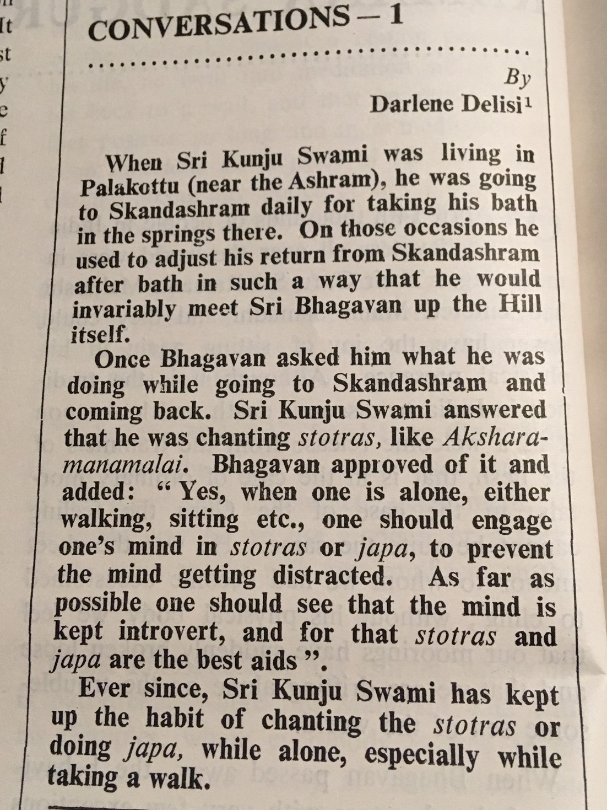

Slide 104
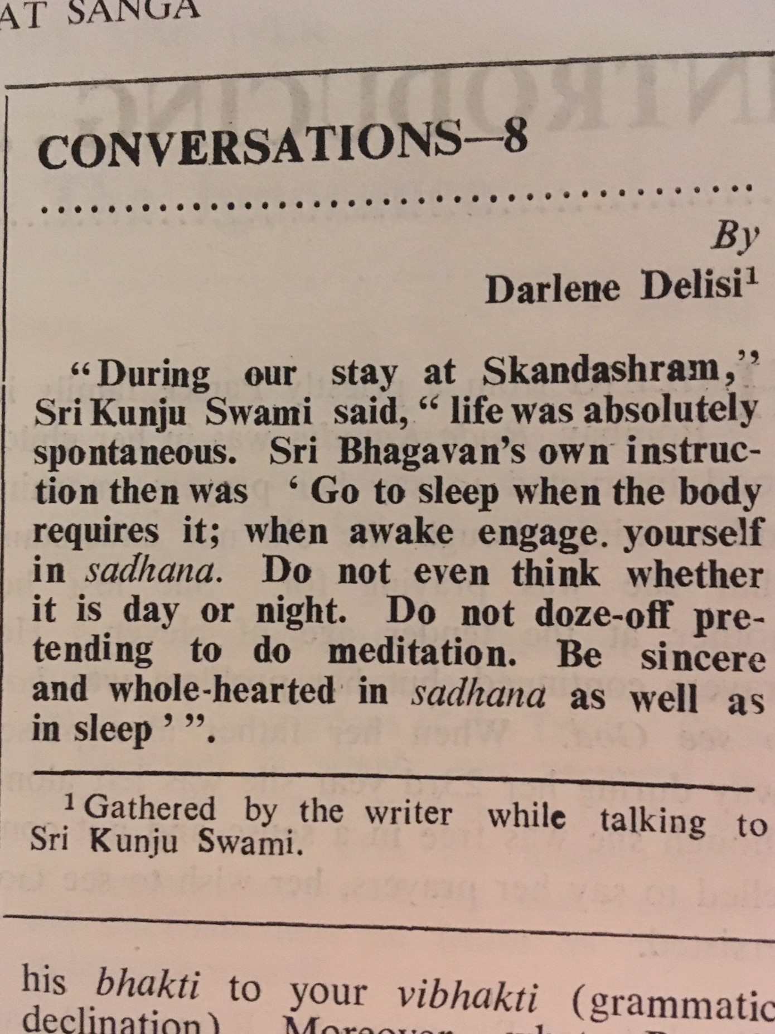

Slide 105
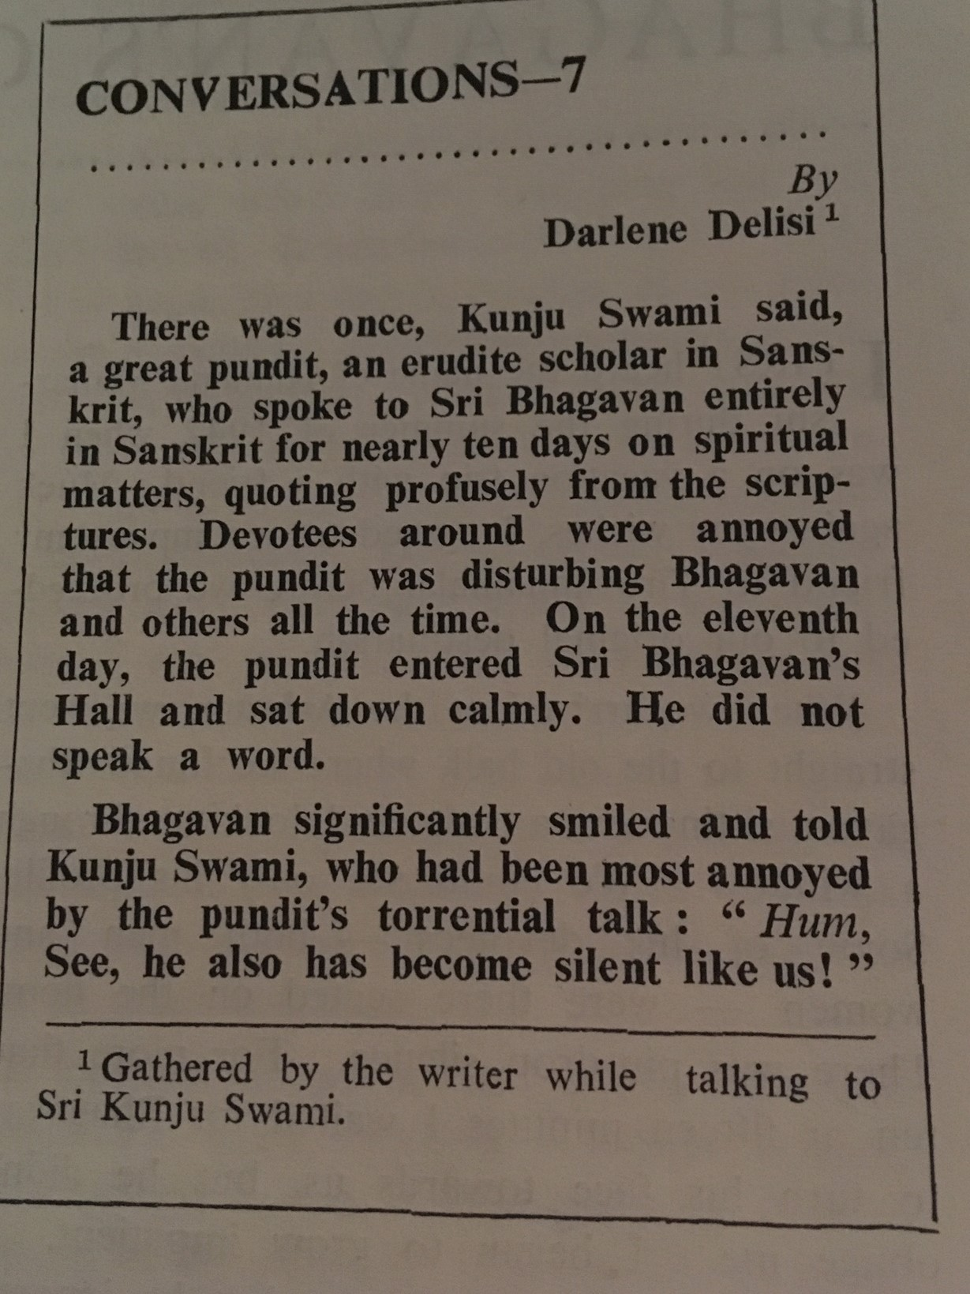

Slide 106
Kunju Swami
When I first heard Sri Bhagavan’s name, I was thrilled. I wanted to go to Tiruvannamalai at once, leaving my parents. But I could not go immediately. Later when I rushed to Arunachala, I got immersed in the Grace of Sri Bhagavan.
He was my Father, Mother, Guru and God. He was, and is, everything to me in this world.
I don’t know what good I have done to deserve his Grace, the Grace that permitted me to serve him. I have tried to communicate the taste and flavour of the nectar of Sri Ramana through my writing. Is it ever possible?

Slide 107
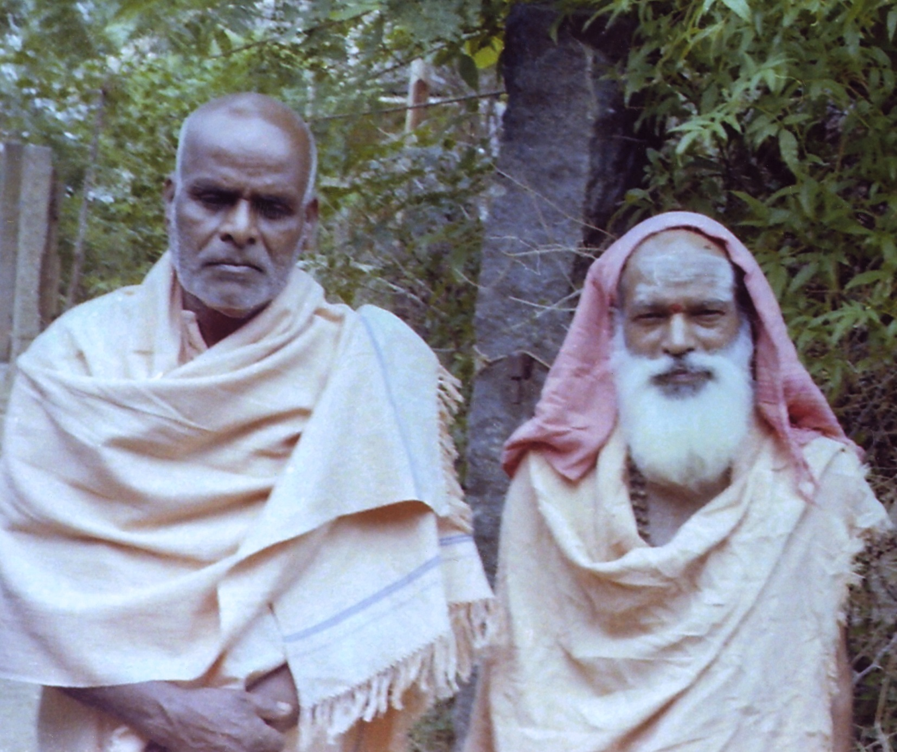

Slide 108
Ramakrishna Swami
Sri Bhagavan used to say that going for bhiksha is a good sadhana and would remove one’s ego and body consciousness.
Ramakrishnaswami would go into town and shout “Bhiksha! Bhiksha!”.
Lakshmi Ammal invited for Bhiksha
asked to recite Siva Purana which he didn’t know and was ashamed.
Bhagavan “I too used to ask for it with indifference but with dignity. It is something that naturally comes to one. Sadhus should be familiar with Siva Puranam and the song from Peria Puranam”
Both Kunju and Ramakrishna used to alternately serve Bhagavan and go for Bhiksha.

Slide 109
Ramakrishna Swami
Chittattin shantiyade siddama mukthi-enil
Chittathin seigai-yindri sidhiyam-sidhikalil
Chittam cher varengan chittakala-kantir
Mukthi sukham toyvar mozhi
…. Ulladu Narpadu Anubandham verse 16
Stilling of mind is true liberation; Miraculous powers are unattainable without an act of the mind. How can those whose minds are set on such powers enter the bliss of liberation which is the ending of all activity of the mind?

Slide 110
Ramakrishna Swami
the meaning of Twaiyarunachala Sarvam, verse 2 in Arunachala pancharatnam
Bhagavan
“The universe is like a painting on a screen - the screen being the Red Hill, Arunachala. That which rises and sinks is made up of what it rises from. The finality of the universe is the God Arunachala. Meditating on the seer, the Self, there is a mental vibration ‘I’ to which all are reduced. Tracing the source of ‘I’, the primal ‘I-I’ alone remains over, and it is inexpressible. The seat of Realisation is within and the seeker cannot find it as an object outside him. That seat is bliss and is the core of all beings. Hence it is called the Heart. The only useful purpose of the present birth is to turn within and realise it. There is nothing else to do.
…Talk 219 Talks with Ramana Maharshi

Slide 111
Ramakrishna Swami
“Pragnya refers to the consciousness that we have of the body and its surroundings. Pragnya is outward awareness.
Gnyapti refers to pure, inward awareness; it is one’s state of natural awareness. For instance, when a person wakes up, there is a state of alertness when he understands that he has woken up and is no longer asleep. This takes place in a short span of time. Though it is a spiritual experience, we do not pay pointed attention to it. the experience does not last because of our compulsive urge to jump out of bed and get into our routine. This state of awareness when there is no movement, which is yet to descend to the level of consciousness, is the state of gnyapti. This is a state that can be experienced by anyone
… Advice given to Sri Ganeshan Ramana Periyapuranam

Slide 112
Madhava Swami
Mounam(Silence) is but the state of Grace that emerges within as One Word
… Bhagavans verse on Silence in Madhava Swamis note book
Original one
Ekam aksharam hridi nirantaram
Bhasate swayam likhyate katham?
One Aksharam(Letter but real meaning Imperishable thing)is itself ever shining in the Heart. Who can write it down?
Madhava Swami surprised Subbaramayya by reciting Telugu version of Bhagawad Gita saram
…. Subbaramayya Reminescences

Slide 113
Madhava Swami
We placed our offerings(cashew nuts and sugar candy) on a stool before him and sat down. The cow Lakshmi was lying near Bhagavan’s sofa. She got up and began to chew our precious offerings.
Bhagavan looked on and said nothing.
His attendant, Madhava Swami, did not even look.
We thought it might be impious to disturb the cow, but soon I got exasperated and exclaimed,
“Please remove the cow!”
Madhava Swami replied: “ Why? I thought you offered those sweets to Lakshmi! ”
…. Varanasi Subha lakshmi Ammal

Slide 114
Madhava Swami
Accidental injury to egg of a sparrow
Bhagavan cried out to Madhava Swami, “Look, look what I have done today!” So saying, he took the cracked egg in his hand, looked at it with tender eyes, and exclaimed, “Oh! the poor mother will be so sorrow-stricken, perhaps angry with me also, at my causing the destruction of her expected little one! Can the cracked egg-shell be pieced together again? Let us try!”
“Let the crack be healed! Cannot this be hatched even now? Let the little one come from the broken egg!”
7th day “Look! What a wonder! The crack has closed, and so the mother will be happy. She will hatch her egg after all! My God has freed me from the sin of causing a loss of life. Let us wait patiently for the blessed young one to come out! ”
Mother bird sat on the egg to hatch
Bhagavan took the baby sparrow in his hand, caressed it with his lips, stroked it with his hand, and showed it to all the bystanders to admire.
…Arunachala Ramana e book 1 biography

Slide 115
Madhava Swami
Mayura Vrittam
1. “O white peacock, speak quick, are you Ayya Swami who saying ‘I will never leave you whatever might happen’ to serve his own Guru, assumed this shape on earth?”
2. “Say O white peacock; are you Madhava so sweet natured who while enjoying the bliss of serving the feet of Sri Ramana was snatched away by dull fate and has returned thus to Sri Ramana on earth?”
This peacock was continuously screaching during Bhagavan’s last days

